Slide 1

Salesforce
The Client Information Hub

Slide 2

What is Salesforce?

Slide 3
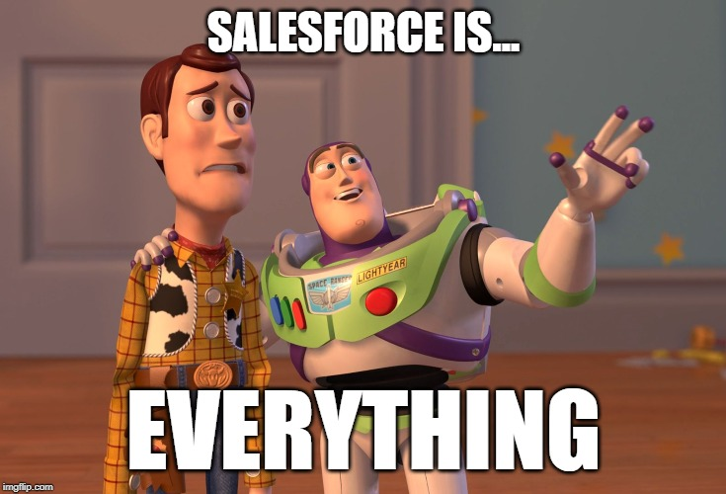
Everything
One-Stop Shopping for Client Information
Account Contacts
Product Info
Case History
Email History
Project History
Sales History
Contracts
Support Notes
Contact Information
Encoder Passwords
Website URL
Granicus URL
At Risk Information
Reporting

Slide 4
Salesforce: A very powerful application when it comes to producing meaningful data for a wide variety of stakeholders
User Experience? Uhh… not so much

Slide 5
And the application is a bit different for everybody
Not every Granicus employee has access to Salesforce
Not everyone has access to every piece of account information
Every Salesforce user has certain permissions
E.G. Customer Support Agents cannot see client contract details

Slide 6

Logging In
With Two-Factor Authentication

Slide 7
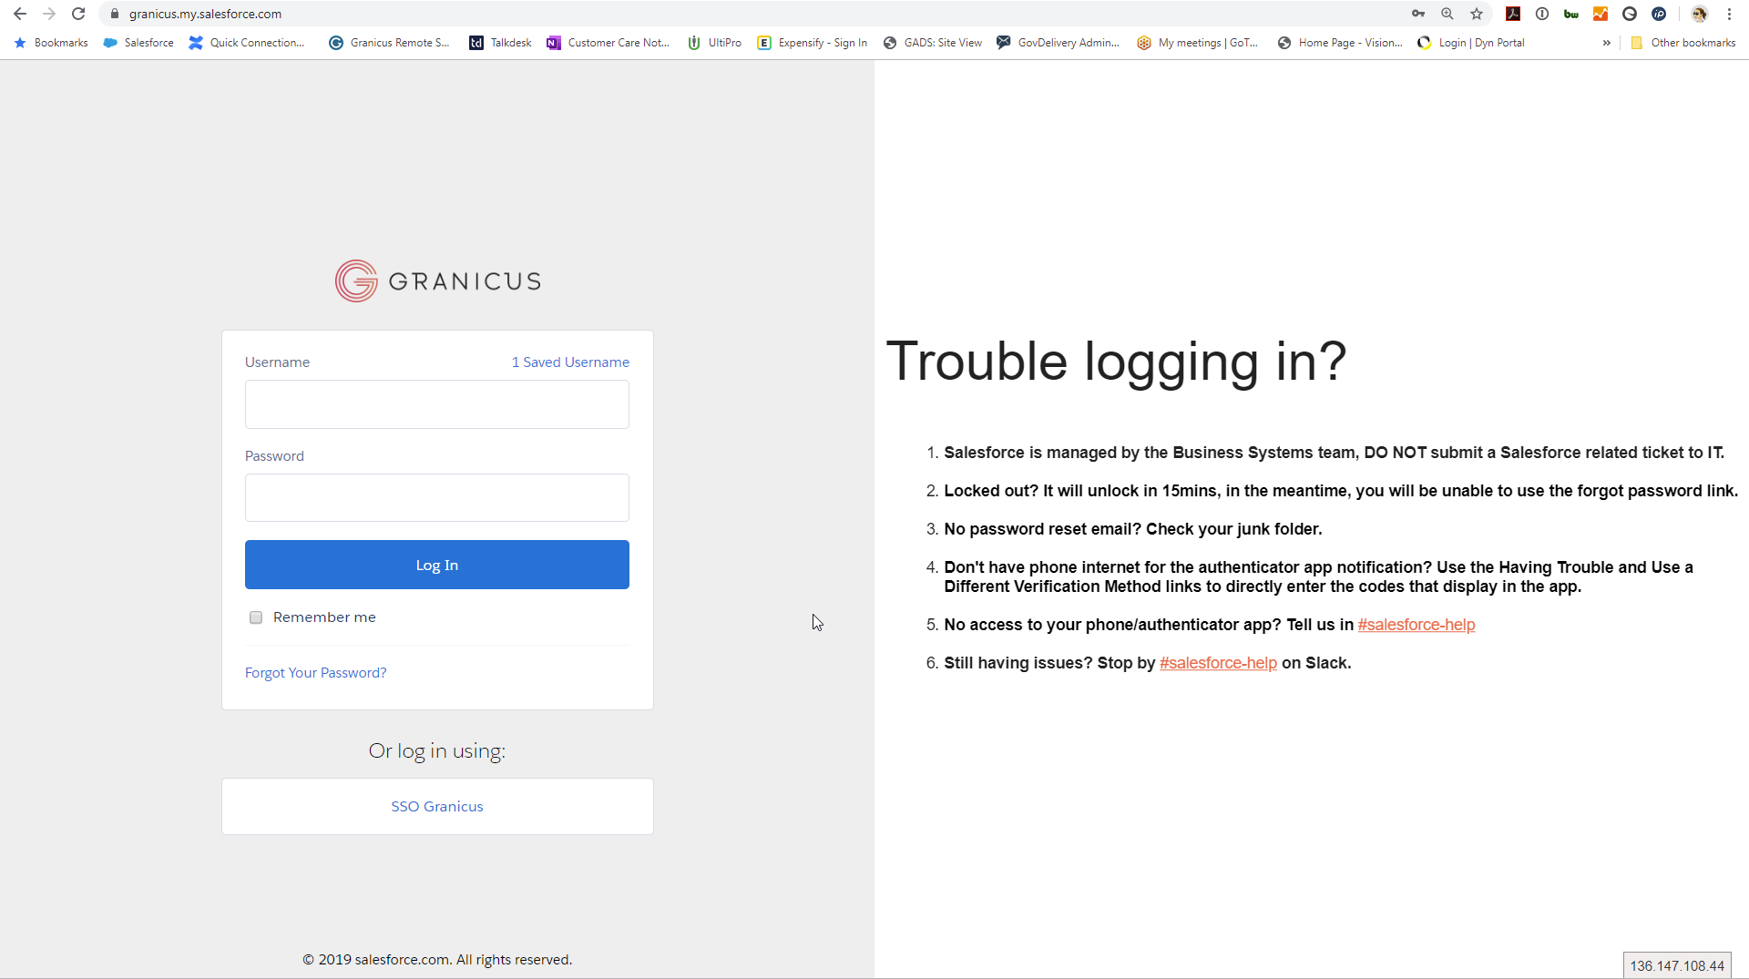
Go To: https://granicus.my.salesforce.com
Your login credentials are your Granicus AD credentials

Slide 8
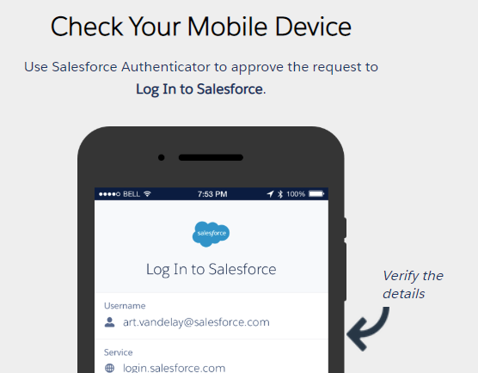
Two-Factor Authentication
You must choose either the phone app or email
To install the Salesforce Authenticator App on your phone, use the URLs shared in the Slack channel for your device: #denver_aug_cohort

Slide 9
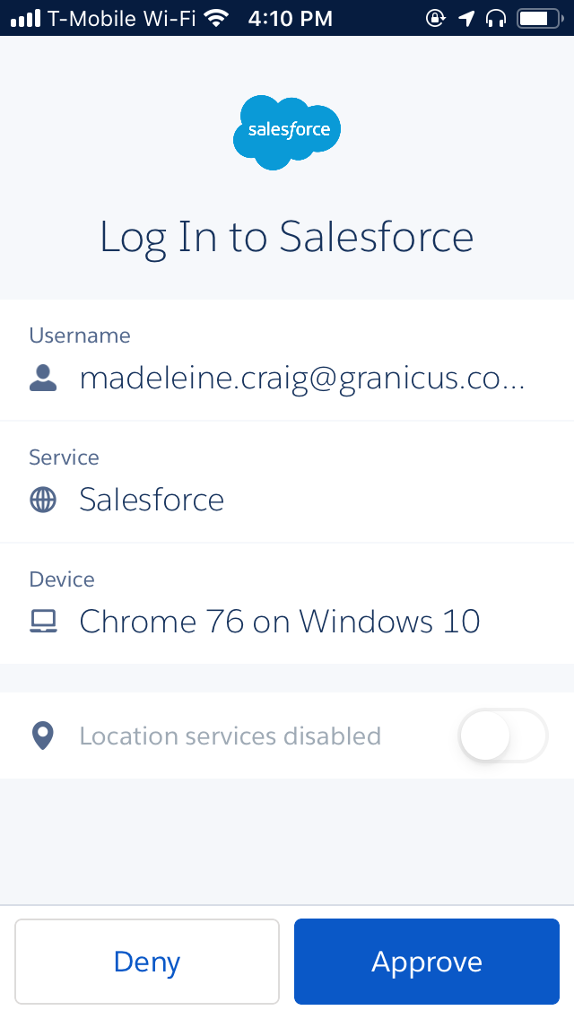
Time to Log In!!!
https://granicus.my.salesforce.com
Install the appropriate Authenticator App on Your Phone
Then log in on your desktop
You should get a notification on your phone
Click the notification and then click ‘Approve’

Slide 10
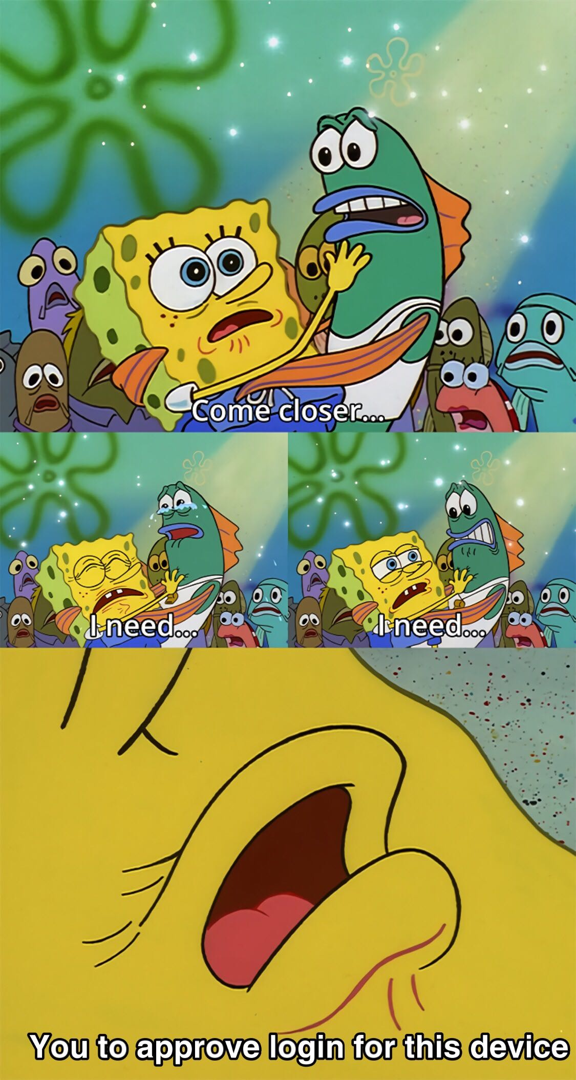
You’re In!!

Slide 11
Navigation in Salesforce
Views, Views, and More Views

Slide 12

Existing Salesforce Views
Different areas of Salesforce have different views and the nomenclature can be confusing.
Don’t worry so much about the names. The most important thing is you know how to find the information you’re looking for.

Slide 13




You can find everything from the Cases view
There are other views, but this info is also accessible from within a case or by using Search
Cases
Accounts
Contacts
Reports
This is your main squeeze in Salesforce. There are links within each case to information from the other views
Rarely used as there is a link to the specific client account within the case – which is much easier
Also rarely used as there is a list of contacts on the client’s account page, which you will get to using the account link in the case
Under Support Dashboard and Support KPI Reports, there are reports where you can see how many cases you’re closing. This is the one area not accessible from a case

Slide 14
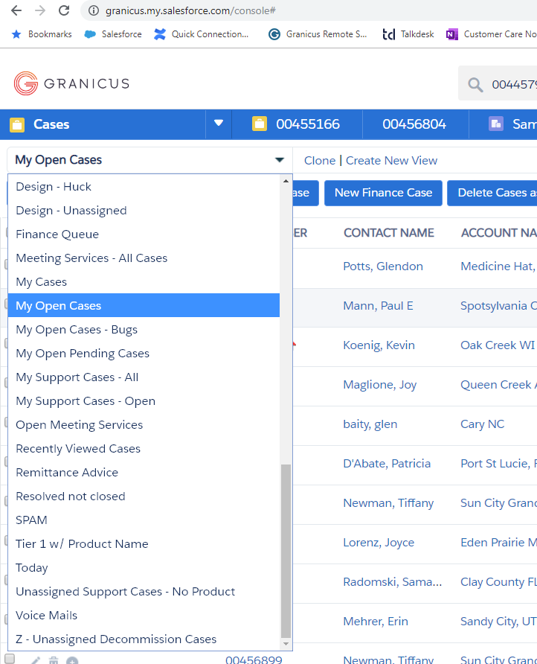
How to See Your Cases from the Cases View
Selecting the Cases view will bring up a secondary dropdown
Scroll down to see the ‘My Cases’ views:
My Open Cases – All your open cases. This is the view you will use the most
My Cases – ALL of your cases, regardless of status, open or closed
My Open Cases – Bugs – All your open cases that have a ‘Pending: Product’ status. Cases that are the result of a bug

Slide 15
CAUTION: Making Your Own Case View
You can customize your case view, but it is not recommended
You CAN do it, but it’s risky.
Agents sometimes create one to rearrange or pull in additional info
BUT, you have to be sure it’s pulling in all the cases you need to be monitoring, and that requires careful construction of conditional logic. It’s easy to get it wrong and end up missing cases
The My Open Cases view was built to do that and was thoroughly tested to pull in all cases that require monitoring

Slide 16
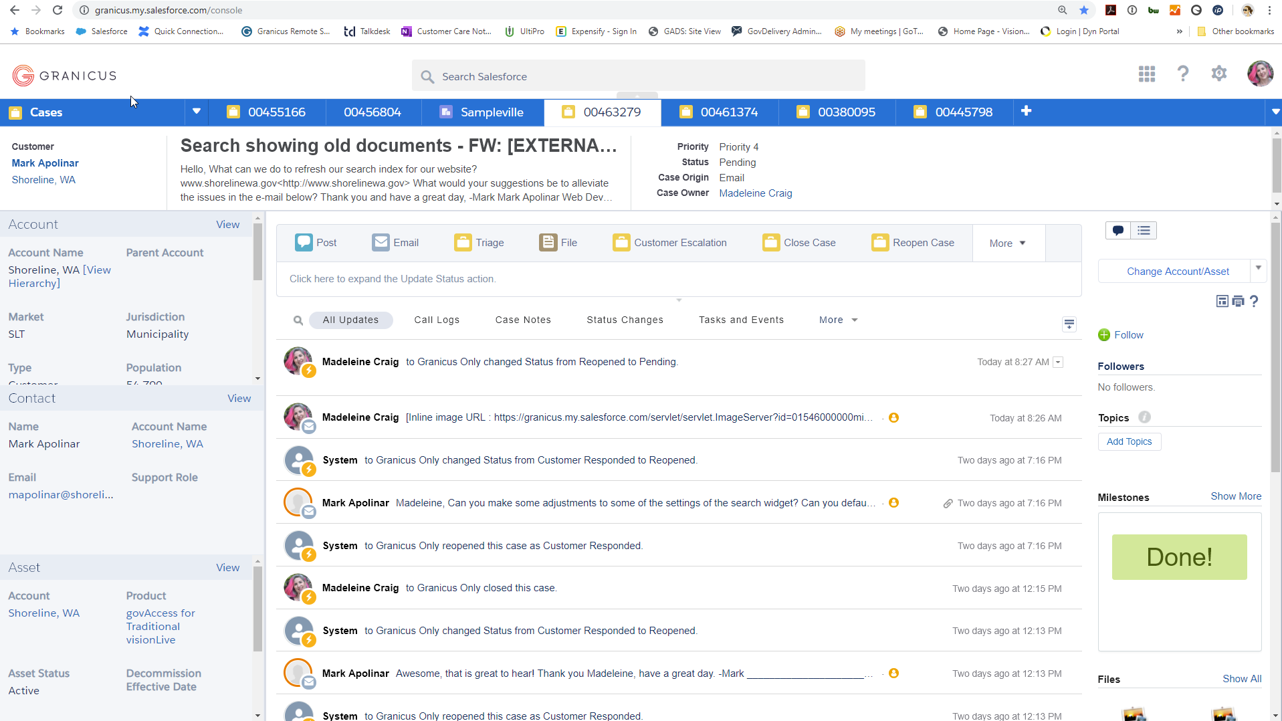
Single Case Views: Console View vs. Classic View
You’ll spend most of your time in the Console View
Why? Because you can have several cases open within one browser tab
Other Salesforce integrations, like Talkdesk and Omni-Channel, will not have full functionality unless you are in this view

Slide 17
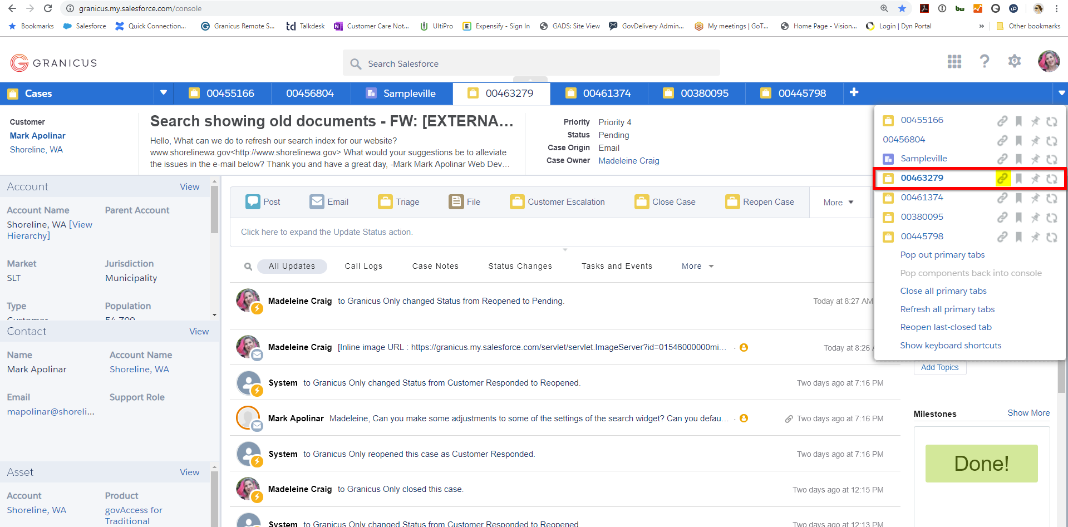
Why would you use the Classic View?
When someone needs the URL of a case
Clicking the white triangle in the upper-right-hand corner of the Console View will drop down a list of open cases, contacts and accounts, along with a series of functions you perform with them.
The link icon is the case URL.
Going to this URL will open up the Classic View of this case

Slide 18
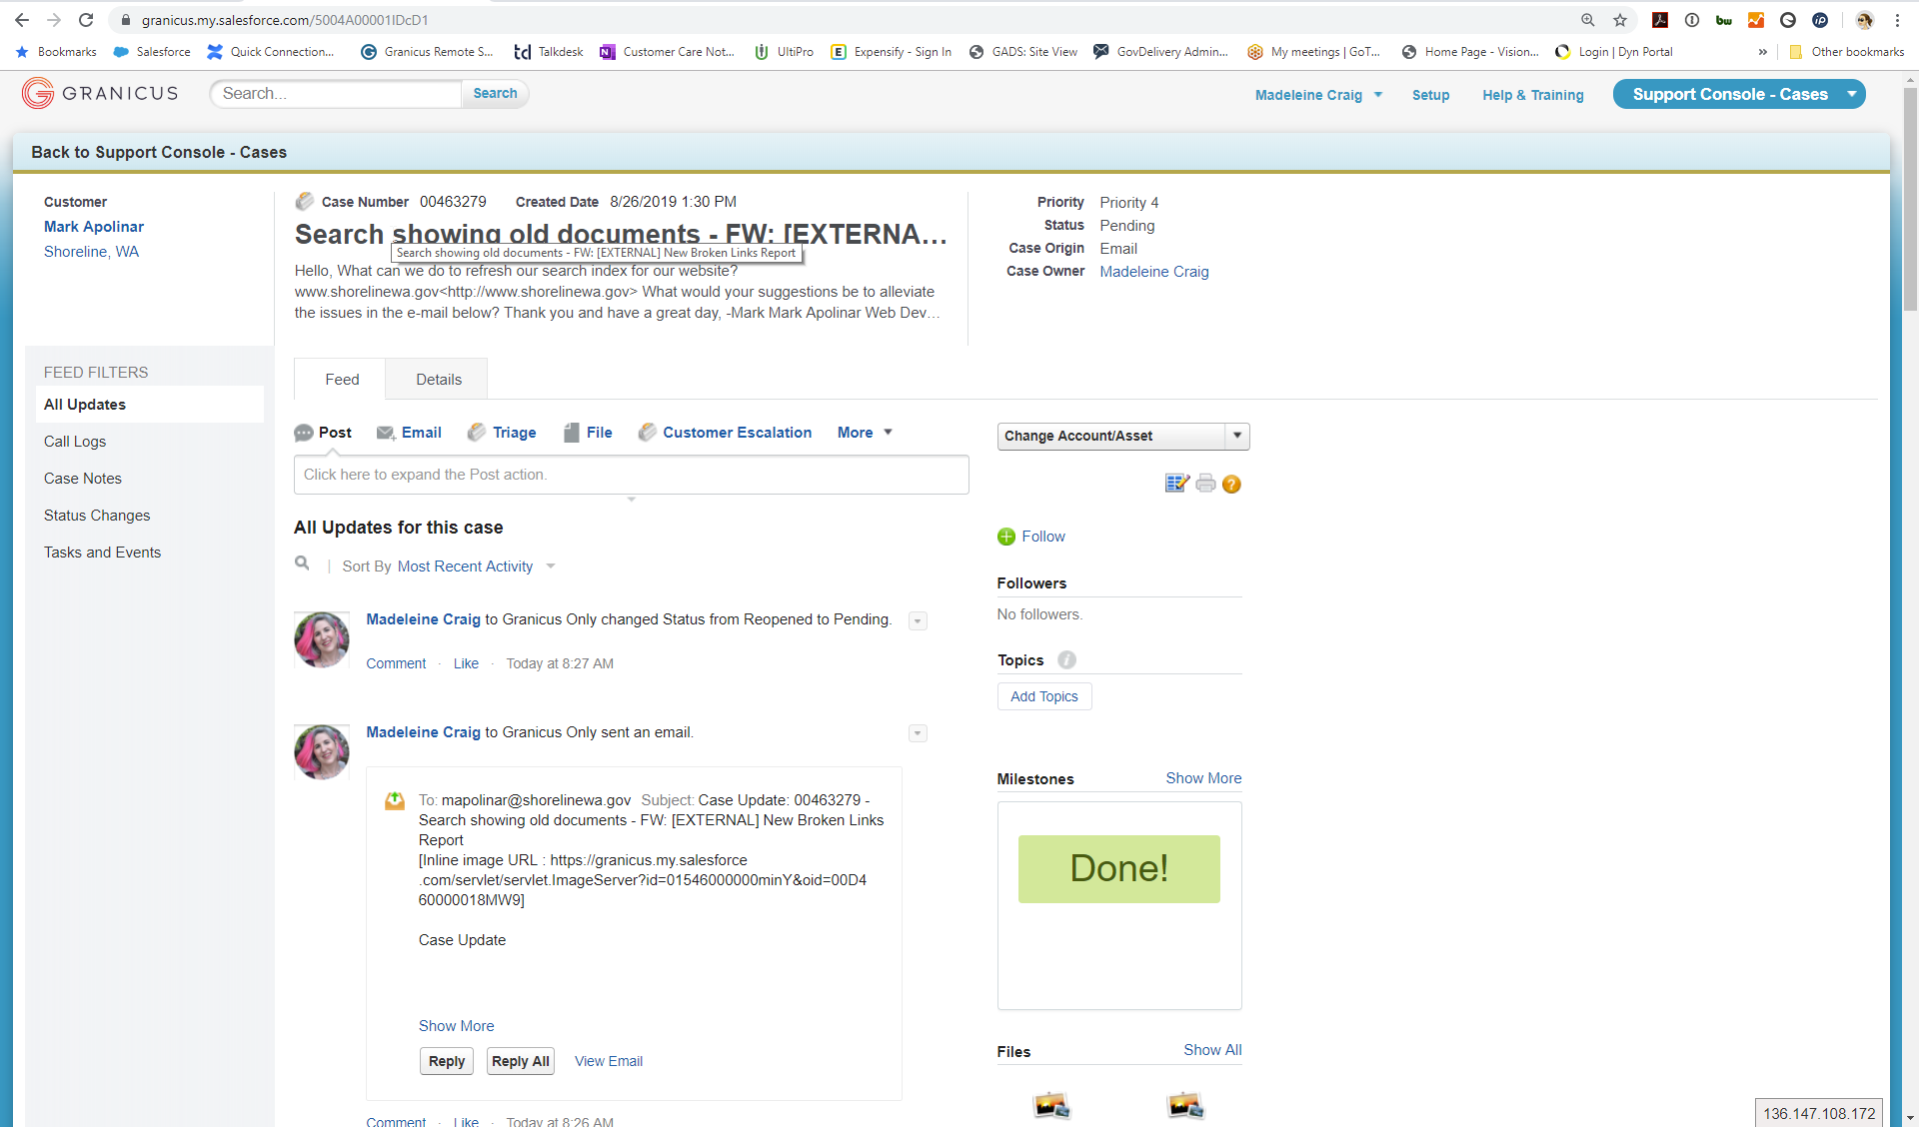
Same Case Info – Less User Friendly
Not 3rd Party Application Integration Friendly
Viewing an additional case, or an account in this view requires you to open another browser tab.
The Talkdesk/Salesforce Chat integration also does not have full functionality in this view.
And you cannot click the contact phone number to call the client when in this view

Slide 19
The Different Case Queues
A single case can show up in multiple queues
There are 3 main queue groups:
Unassigned queues – Prefix 0
General and priority queues – Prefix 1
Product group queues – Prefix 2
Specific product queues – Prefix 3

Slide 20
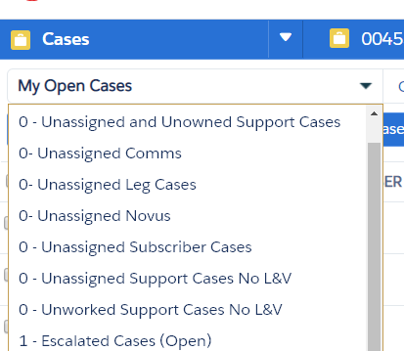
Unassigned Queues
Prefix 0
Unassigned and Unowned: neither a contact or a product have been assigned to the case
Unassigned Leg, Unassigned Comms, Unassigned Novus – cases in these product groups that have not been assigned to an agent
There is no unassigned GovAccess. Those unassigned cases will be in the Vision or the Civica queues

Slide 21
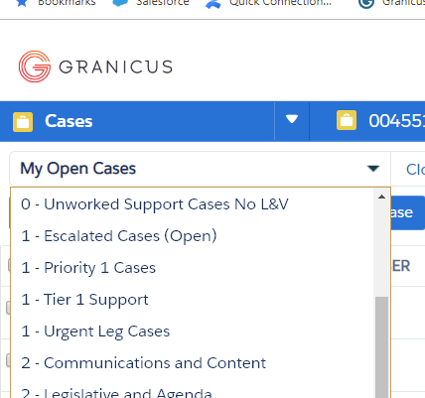
General and Priority Queues
Prefix 1
Escalated Cases: either the client or a Granicus team member has formally escalated the case
Priority 1 Cases – cases related to a Priority 1 service event
Tier 1 Support – cases still assigned to Tier 1 Support (i.e. all unassigned cases)
Urgent Leg Cases – Urgent and escalated legislative cases

Slide 22
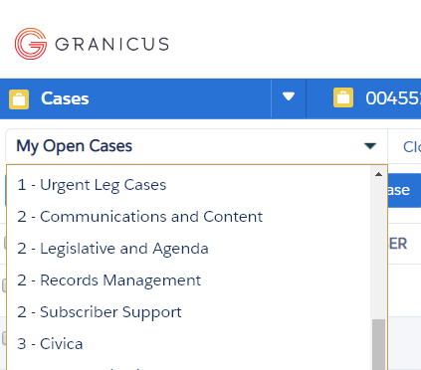
Product Group Queues
Prefix 2
NB: these queues were named before marketing rebranded product categories
Some cases in these queues may be assigned to the product group, but not the specific product
All cases assigned to a specific product will also appear in the appropriate product queue

Slide 23
Product Group Queues
Prefix 2
GovDelivery
Civica
Vision
NB: you’ll see here how these names are not consistent w/ marketing names

Slide 24
Product Group Queues
Prefix 2
MediaManager, LiveManager, Encoder/Meeting Server
VoteCast
Boards and Commissions
Peak
Legistar
Novus
IQM2

Slide 25
Product Group Queues
Prefix 2
ROAM
Land and Vitals

Slide 26
Product Group Queues
Prefix 2 – Subscriber Support
This queue is dedicated to issues with GovDelivery subscribers
Issues with not receiving emails
Wishing to unsubscribe or user was inappropriately subscribed
User has mistaken Granicus for the agency sending the email

Slide 27
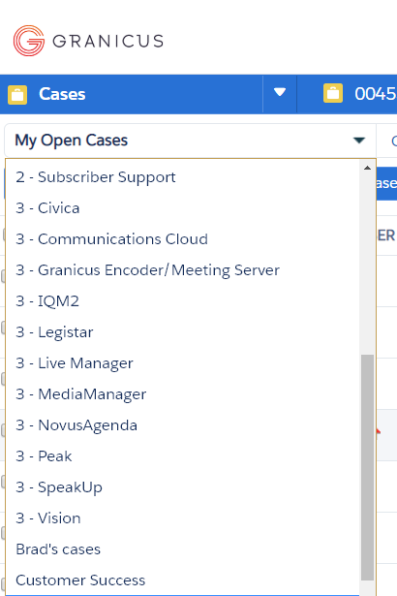
Specific Product Queues
Prefix 3
If a case has a specific product assigned to it, it will show up in the specific product queue
I will also show up in a product group queue

Slide 28
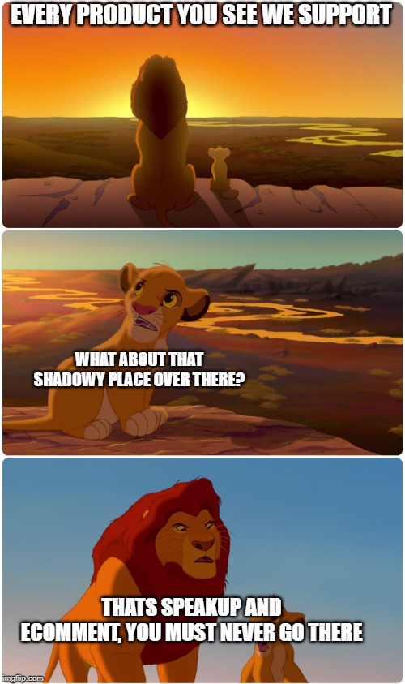
Let’s look at some queues!
Take a look at the product group queues for the products you’ve been trained on during this boot camp
Take a look at the specific product queue for a product you’ve been trained on
Open several cases from that queue
Click on the triangle in the upper-right corner, click on the link icon, and open up the classic view of that case in a new tab

Slide 29
Views Within a Case
Detail Case View
Feed Case View
Left Panel Client and Account Information
Right Panel Knowledge Base

Slide 30
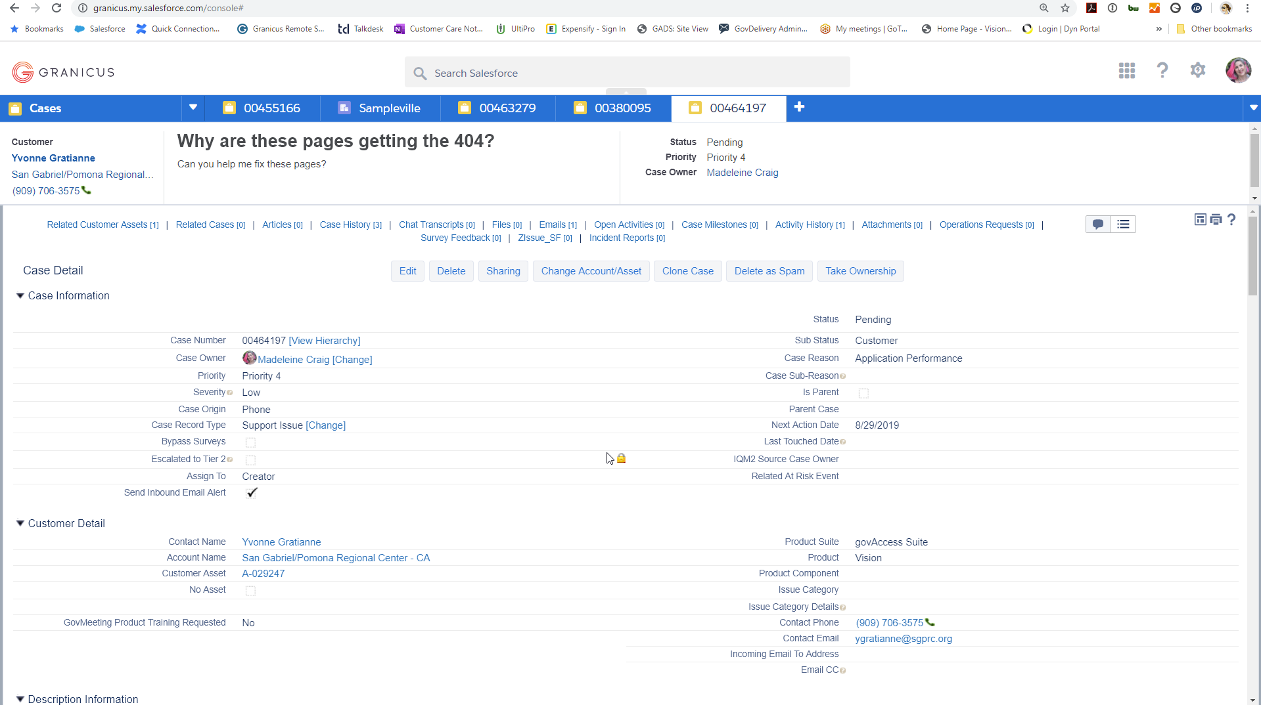
Detail Case View
General Case Information
Case, Client, Product, and Account details are found in this view
You create JIRA tickets from this view (TECH, GPS, CSI, CER, GAIT, etc.)

Slide 31
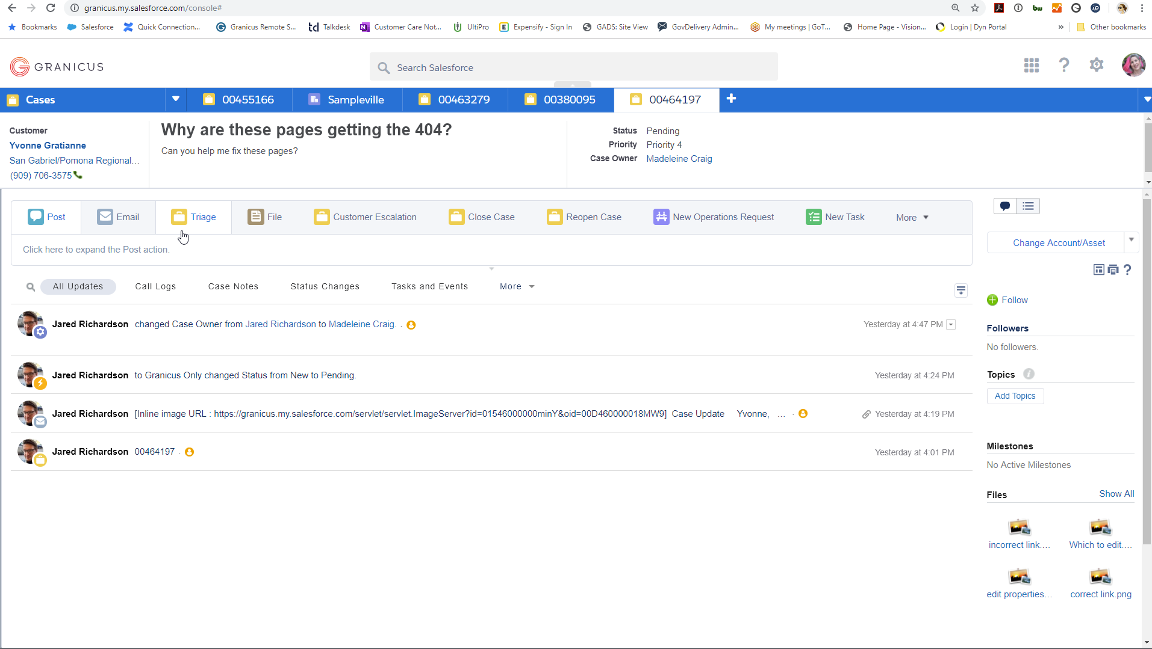
Case Feed View
Case and Client Communication
This is the view where communication with the client happens
You can post case notes here
Notes from other teams (TSE, Dev, CSC) will appear here as well

Slide 32
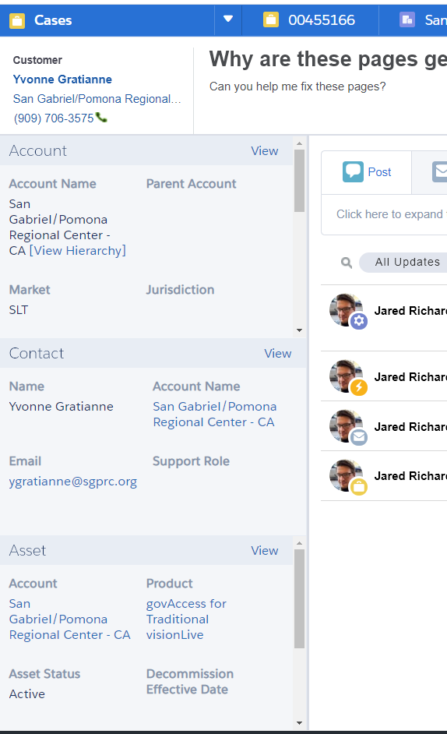
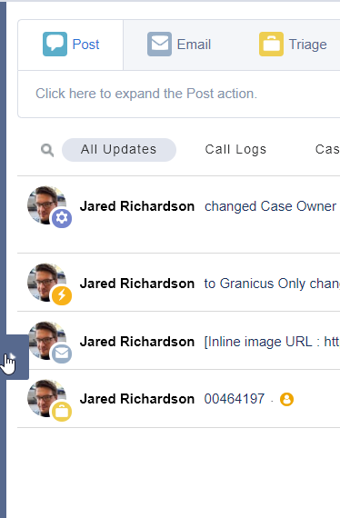
Left Panel Slide Out
Client and Account Information
Hovering over the left edge of the screen will reveal the left panel slide out tab
This panel contains general client information
It also contains a link to the client’s Granicus site, if applicable, and links to Support Notes
You may need to scroll in the different sections to see information

Slide 33
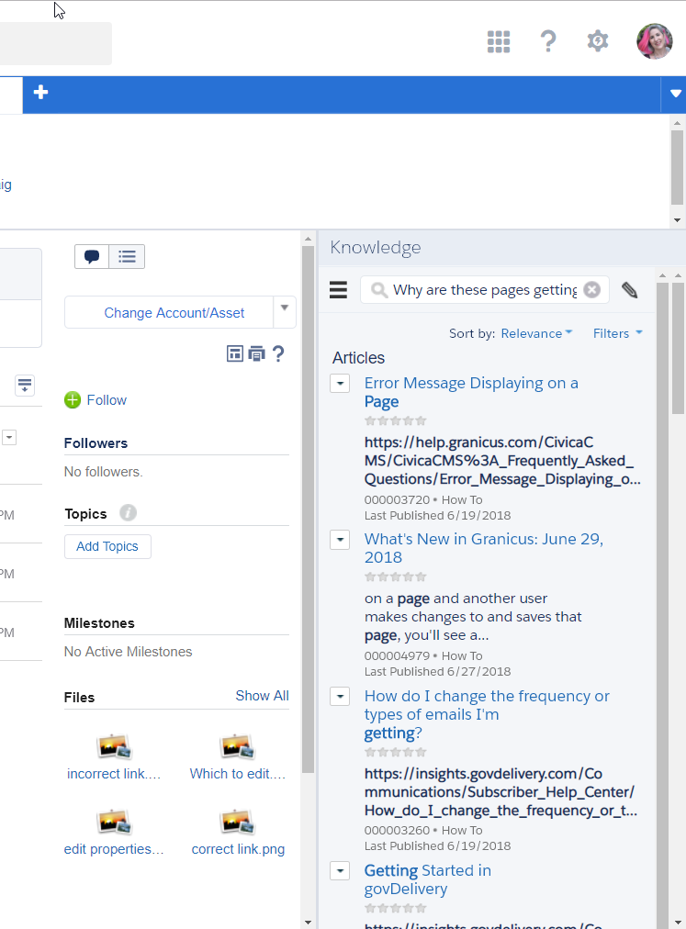
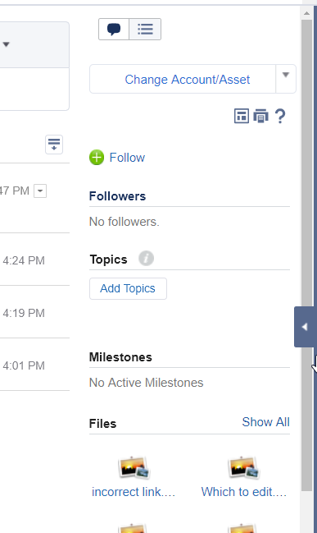
Right Panel Slide Out
Knowledge Base
Hovering over the right edge of the screen will reveal the right panel slide out tab
You’ll find lists of Knowledge Base articles that may or may not be relevant to the case you’re creating
Email an article to a client or attach it to the case using the dropdown icon next to the article

Slide 34
Assigning an Existing Case
To yourself or to others

Slide 35
Take Ownership
Assigns the case to you and emails the client that case has been assigned
You must be in Detail View to assign a case
Click the ‘Take Ownership’ button

Slide 36
Change Case Owner
Assign a case to you or someone else
Only way to assign a case to someone other than yourself
Click the ‘Change’ link next to the case owners name
Type the name of the person to whom you like to assign the case
Their name should pop up underneath the field
Click the name and hit save

Slide 37
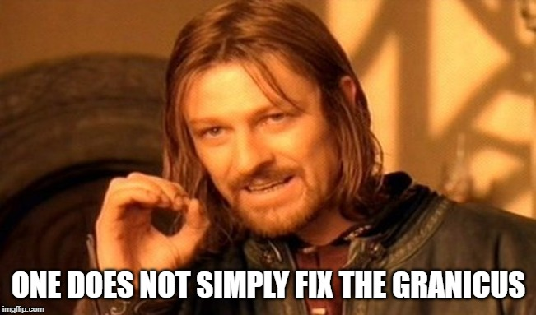
Let’s Assign Some Cases!
Find 3 cases for products on which you have been trained
Assign one to yourself by taking ownership
Assign another to yourself by changing the case owner to yourself
Assign the 3rd to a cohort mate who has been trained on that product

Slide 38
Creating a New Case
It’s all about the contact

Slide 39
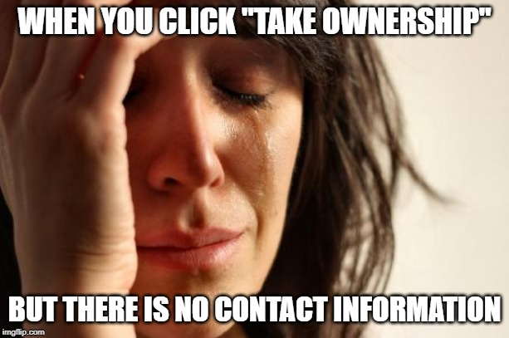
First Things First
You cannot create a case without a contact
Cases created via email or chat sometimes get created without a contact
However, you as a support agent cannot create a case without a contact
And you cannot take ownership of a case, or change a case owner, without first assigning a contact

Slide 40
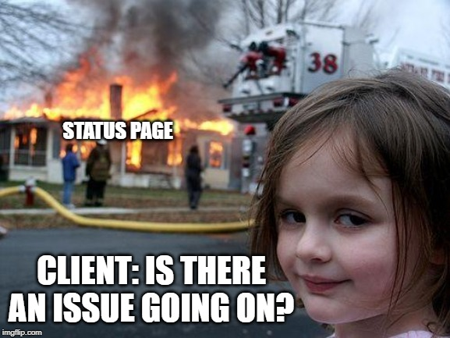
Searching for a contact
Just type the contact name in the Search Bar
They may or may not come up when you search
You also can search for the jurisdiction and scroll through the account contact lists
You can search for a phone number or an email
If you cannot find them, you will need to enter them into the system as a contact

Slide 41

Time to Search for a Contact
Pull a name out of the envelope and search for that contact
Type the name in the Search Bar
Click the client name
Type the Jurisdiction ‘Sampleville’ in the Search Bar to search for your contact via the account
Click the client name

Slide 42
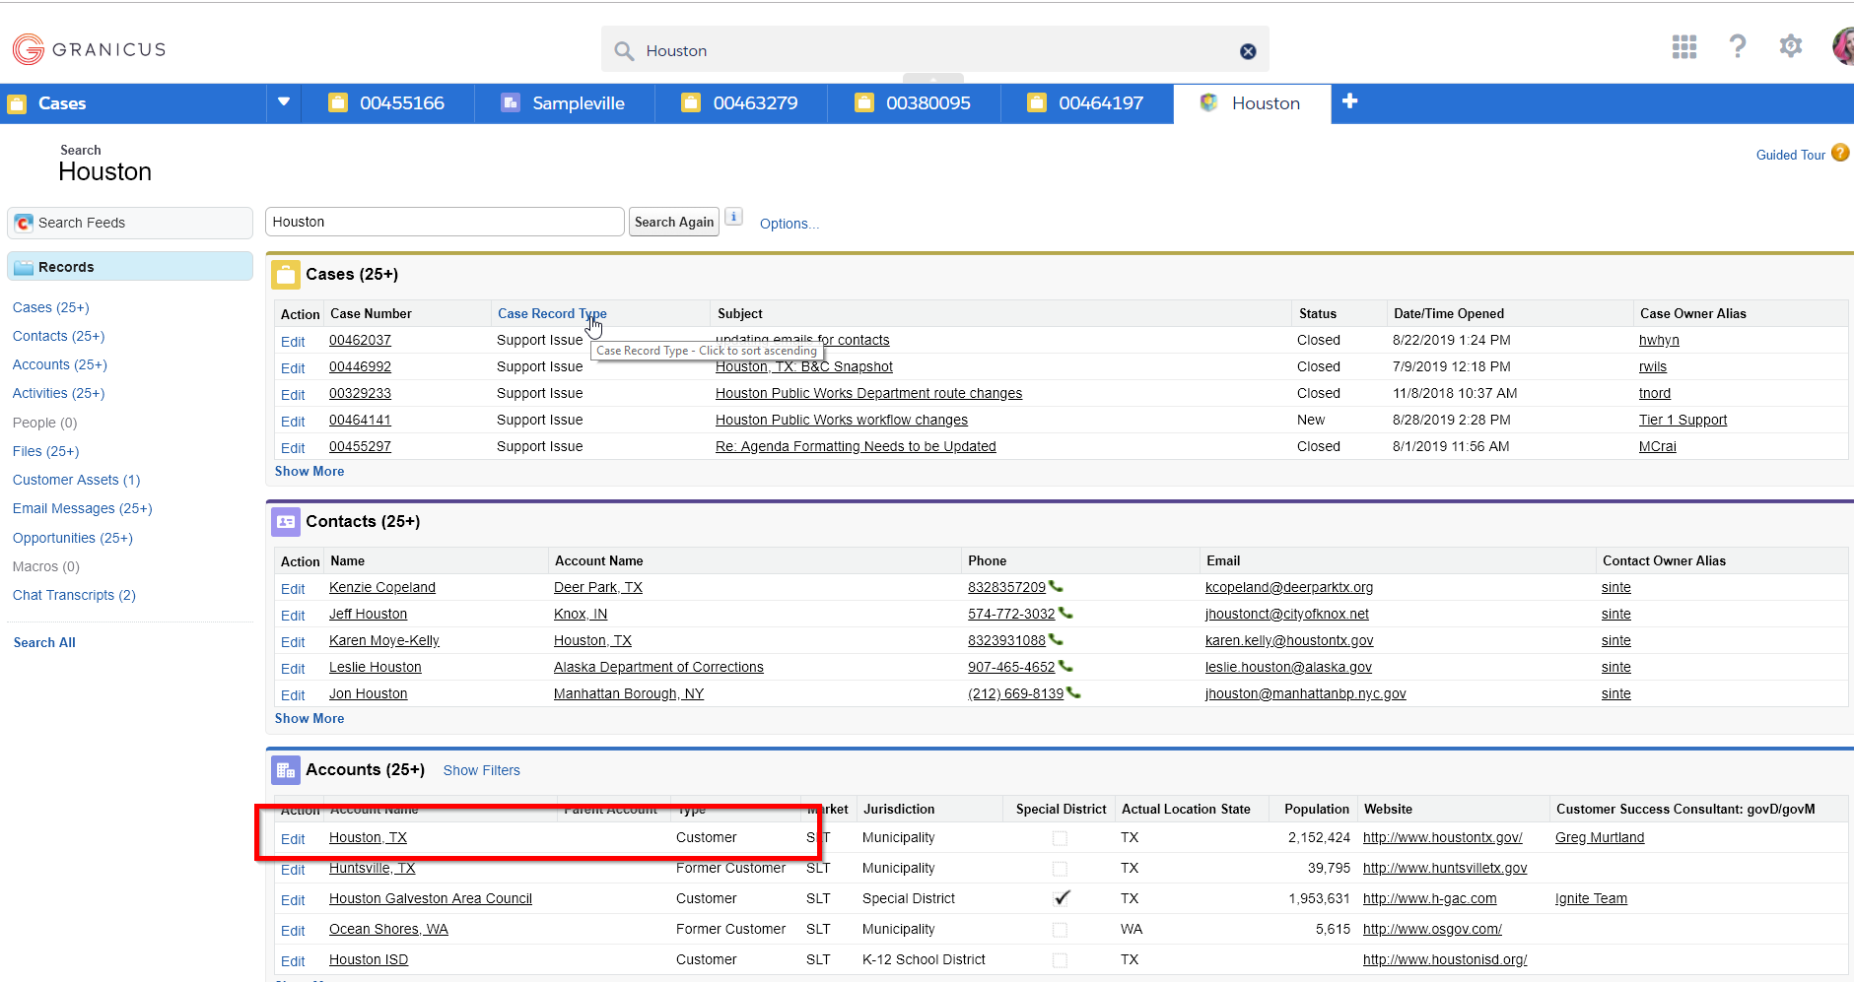
Creating a Contact
When the contact calling or emailing is not in SF
Type the name of the agency or jurisdiction to which the client belongs in the search bar
Click on the appropriate account
If there are multiple possibilities, make sure the account type is customer. That can help narrow it down.

Slide 43
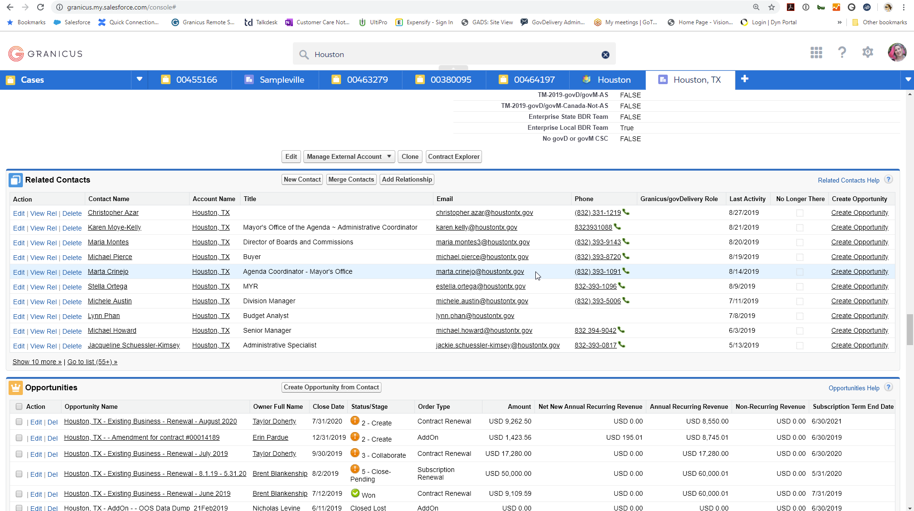
Creating a Contact
When the contact calling or emailing is not in SF
Scroll down the account page to the ‘Related Contacts’ section
Click the ‘New Contact’ button

Slide 44
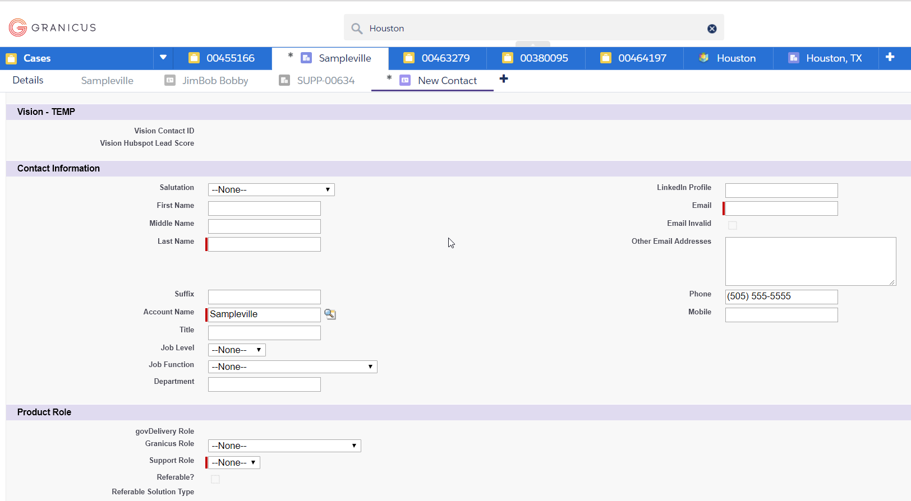
Let’s Create a New Contact for Sampleville!
Pull a name out of the envelope and create that contact
Scroll down the New Contact page to the ‘Contact Information’ section
Fill in:
First Name
Last Name
Email
Phone
Support Role
Scroll to the top and click ‘Save’

Slide 45
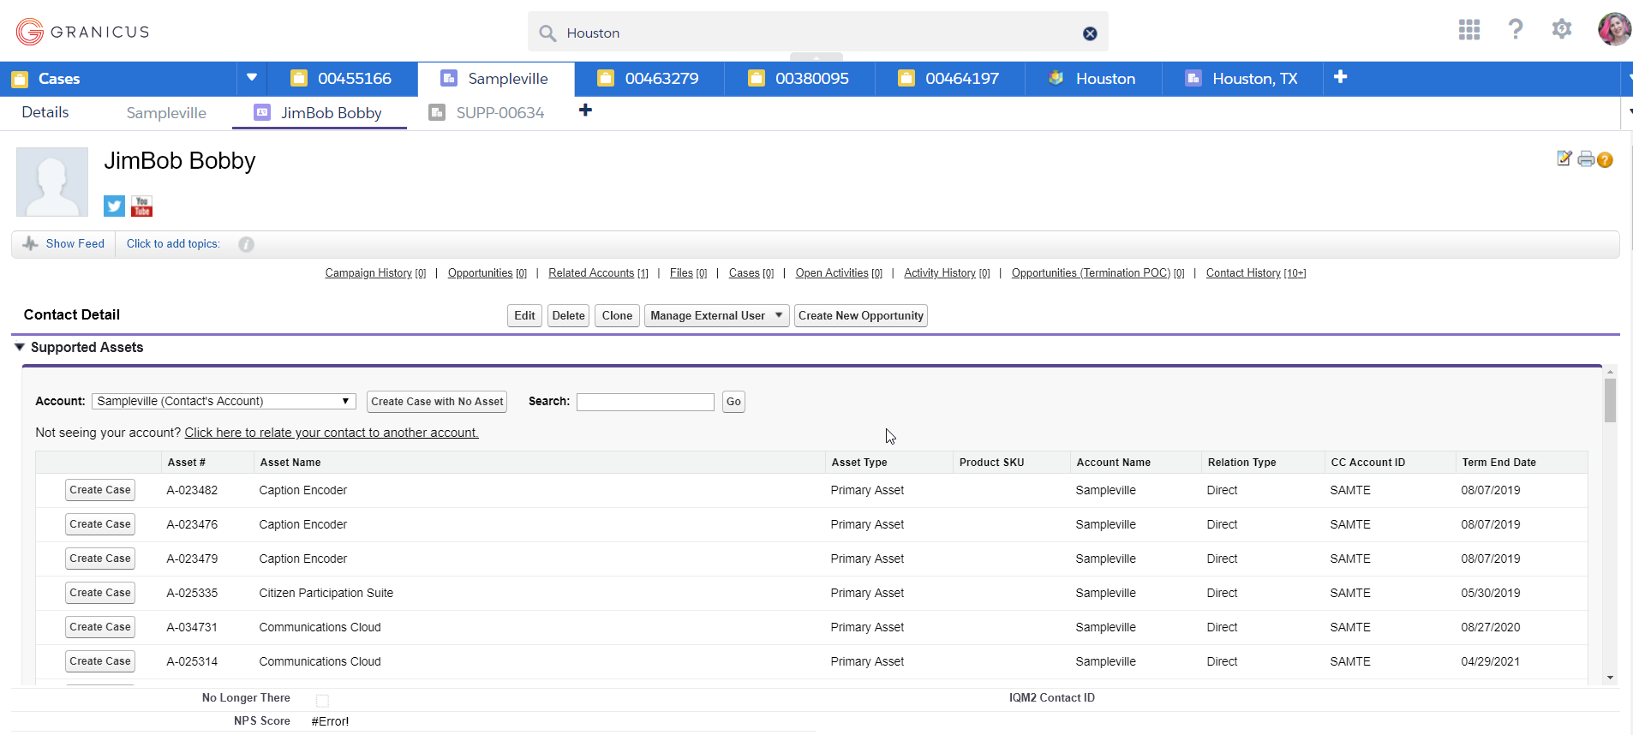
NOW we can create a case
But the case also needs to be created with an asset
Supported Assets are the products which the client has purchased
Asset names can sometimes be vague, especially for leg
Not sure? Choose an asset within the product group
Click the ‘Create Case’ button

Slide 46
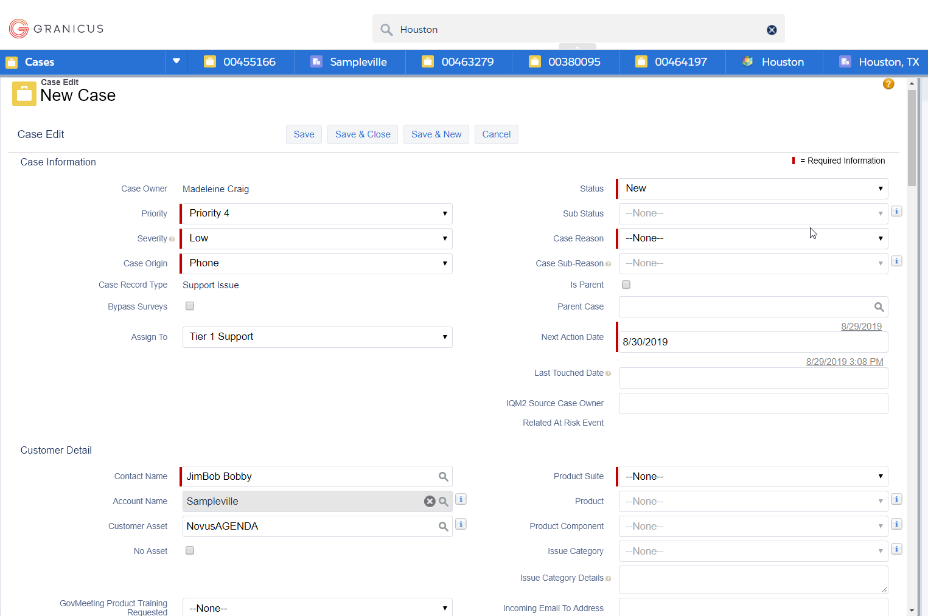
The Case Creation Fields
Assigning a case to a queue or an agent
Case assignment defaults to Tier 1 Support
If you are not taking the case, leave this field alone
If you are taking the case yourself, click the dropdown arrow to the right and select ‘Creator’

Slide 47
The Case Creation Fields
Setting a case priority
Priority 4 is the default – normal priority – will be used for almost all cases
Priority 3 – major feature not working for 1 client w/ acceptable workaround (rarely used)
Priority 2 – major feature not working or system down w/ no workaround for 1 client (rarely used)
Priority 1 – major feature not working, or application is entirely down. No workaround. Affects more than one client or all clients

Slide 48
The Case Creation Fields
Setting a case severity
This is a subjective gauge of the client’s disposition in reporting the case
Default is low and is used for almost all cases
Increasing severity will make it stand out in the queue as it let’s CSRs know client is more upset or situation is urgent
Best to also ping product Slack channels and give them a heads up that an urgent case or a case for an upset client is in the queue
Include case number so it’s easily found

Slide 49
The Case Creation Fields
Other Case fields that should be set
Status
Case reason
Application Performance
Application Usability
Design Request
Audio/Video
Product Suite
Product
Product Component

Slide 50
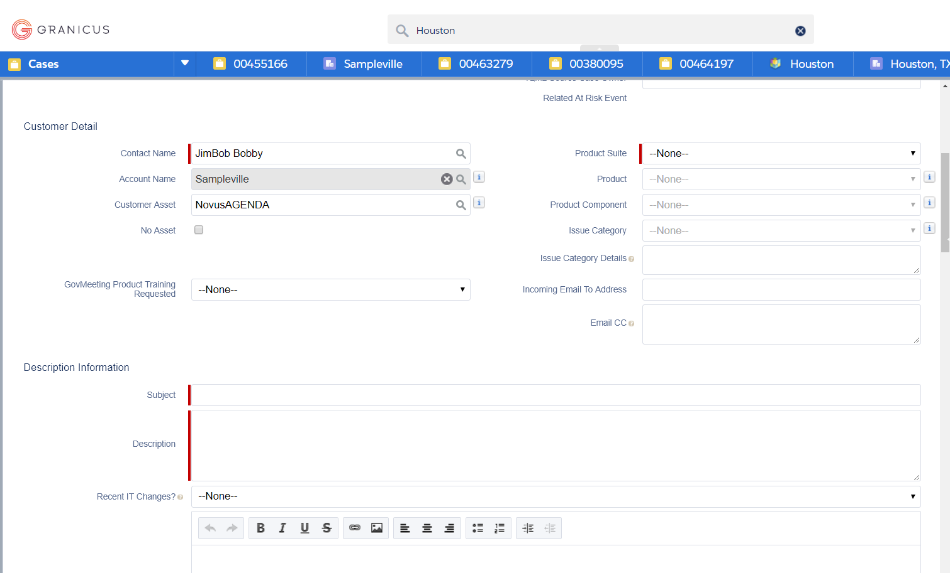
The Case Creation Fields
Other Case fields that should be set – Subject and Description
These fields are client facing – what is typed in here is included in the case creation email that is sent to the client
Be as descriptive as possible in the description field
Pro tip: take notes in Notepad and then copy and paste when you’re ready to create the case

Slide 51
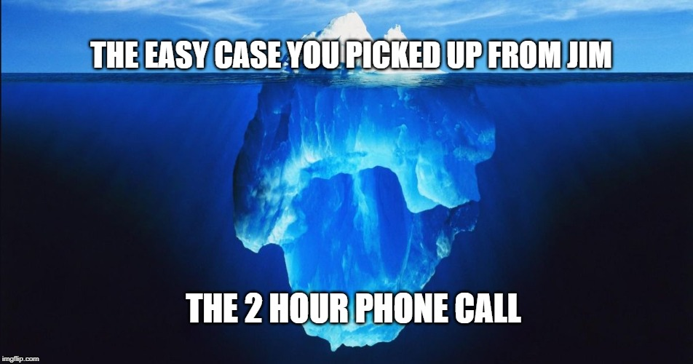
Time to Create a Case!
Create a case for the contact you just created
Use a scenario that was covered in your product training
Be as specific and as descriptive as possible
Include relevant details such as meeting type or bulletin name, page URL, dates, user names, browser, etc
Will what you wrote make sense to another agent who may be picking up the case?

Slide 52
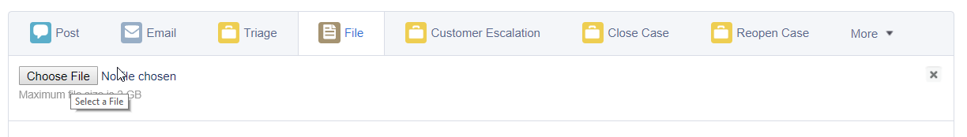
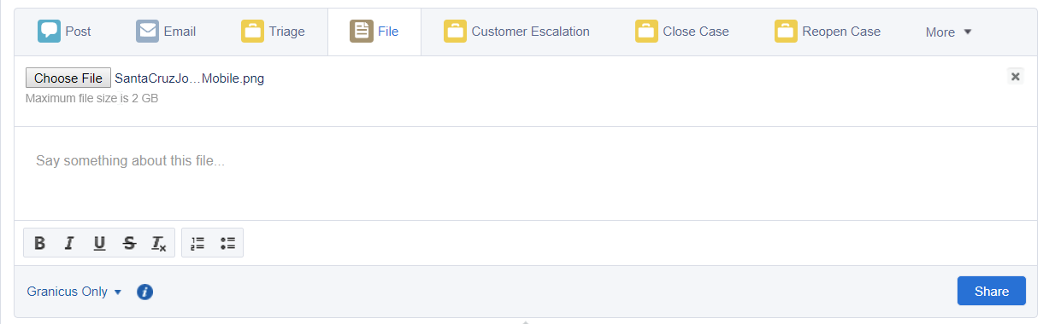
Uploading Files
Screenshots and supporting docs are your friends
You need to be in the feed view of the case to upload a file
At the top of the feed, click the file icon
Choose the location from which you are uploading
Select the file
Click the ‘Share’ button at the bottom-right of the upload area

Slide 53
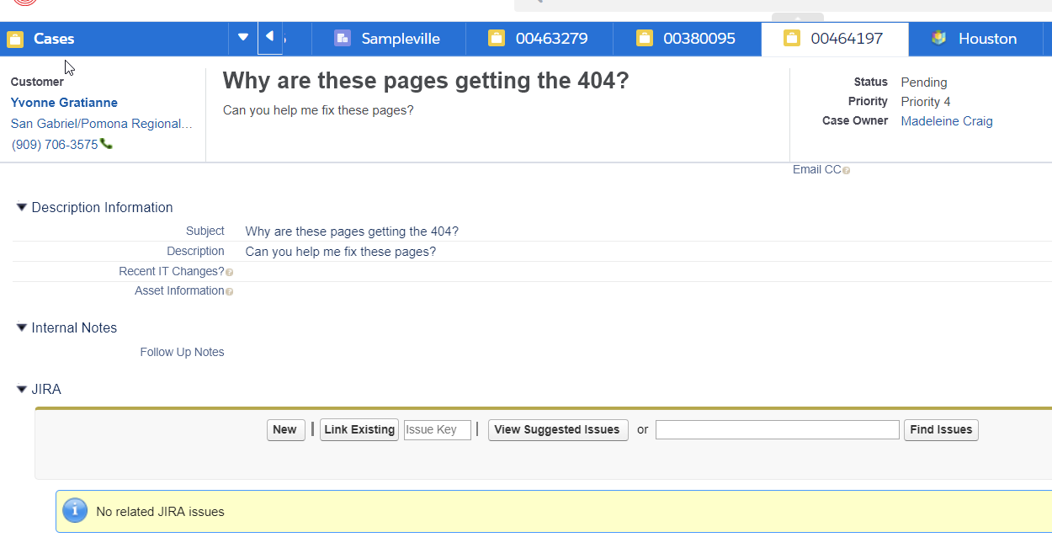
Linking JIRA tickets
How to link the case to a Tier 2 team
You need to be in the Case Detail view to link a JIRA ticket
Scroll down to the JIRA section
Enter the JIRA ticket number in the ‘Issue Key’ field
Click ‘Link Existing’

Slide 54
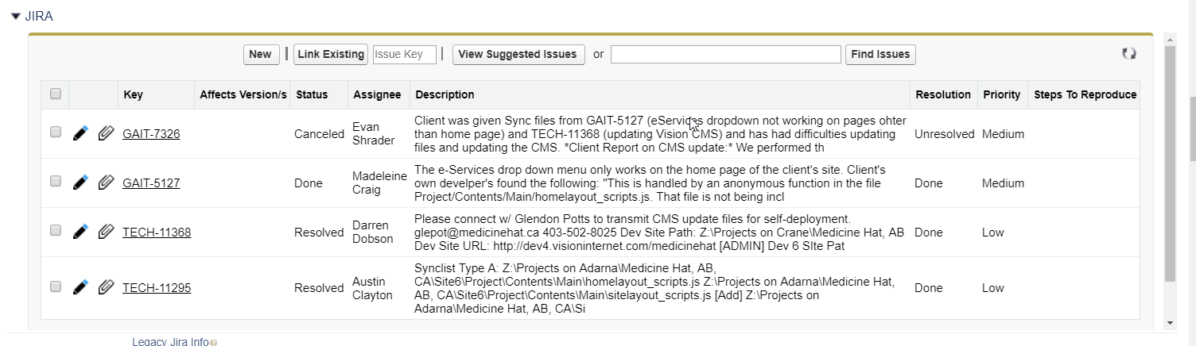
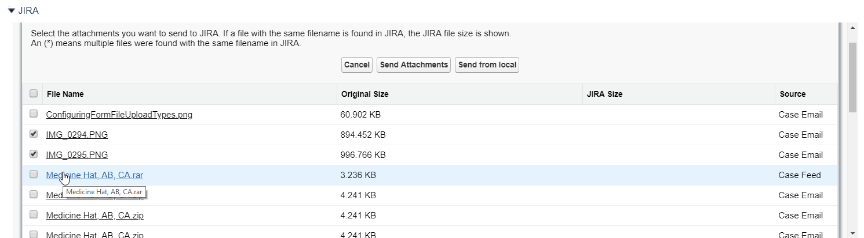
Linking attachments to JIRA tickets
How to link the case to a Tier 2 team
Attachments need to already be linked to the Salesforce case before you can link them to a JIRA ticket.
On the left-hand side of the name of the ticket, click the paperclip icon
Select the attachments you would like to attach to the JIRA ticket
Click the ‘Send Attachments’ button

Slide 55
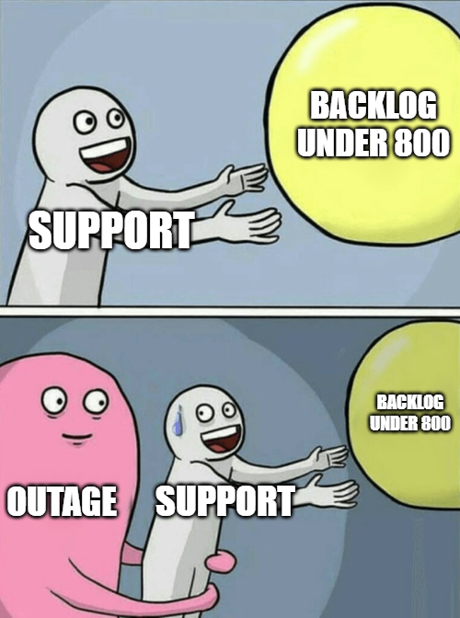
Let’s practice!
Link a JIRA case and attach case files to the JIRA
Upload any two files from your computer to the case you created
Link TECH-13261 to the ticket you created
Attach the files you uploaded to the JIRA ticket you linked

Slide 56
Communicating in Salesforce
Emails and Posts

Slide 57
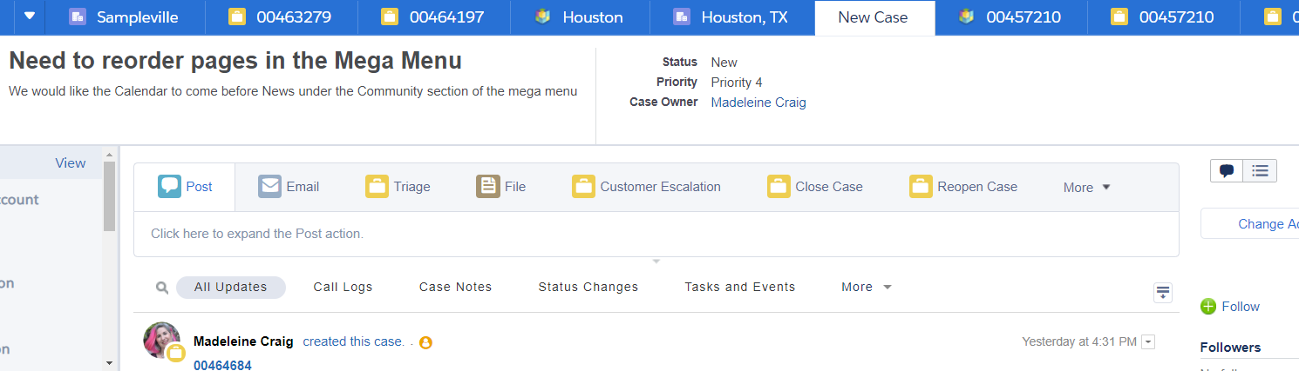
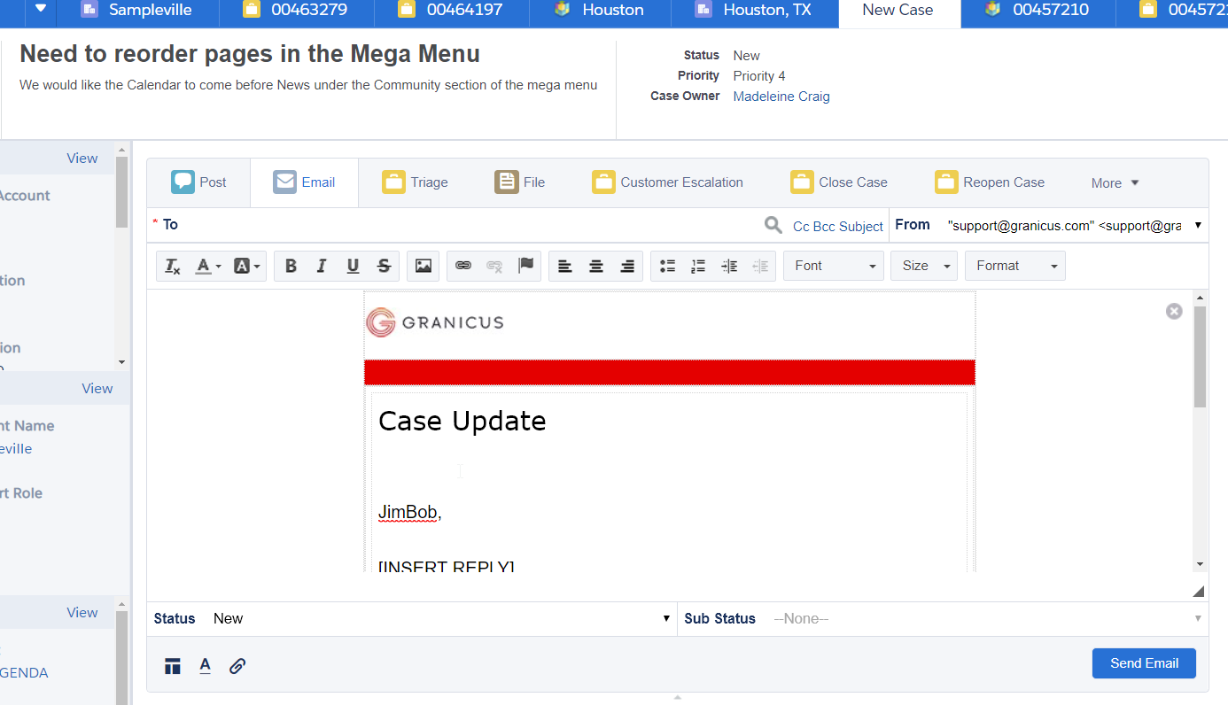
Email
Internal communication with the client
You need to be in the Feed View to send an email
Click the ‘Email’ button at the top of the Feed View
Compose Email
Click ‘Send’

Slide 58
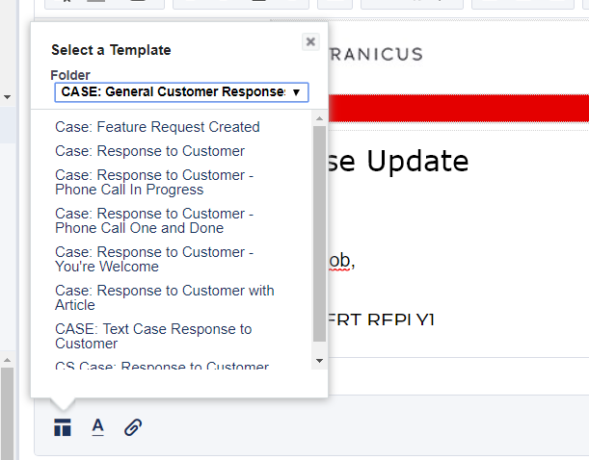
Email Templates
Canned responses for common email types
The default email that comes up is the ‘Response to Customer’ template in the ‘CASE: General Customer Response’ folder
To choose other email templates, click the template icon in the bottom-left of the window
You can select other templates as appropriate

Slide 59
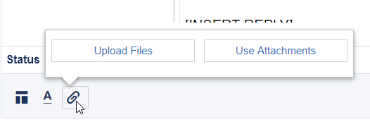
Email Attachments
Upload Files or Use Case Attachments
Click the paper clip in the lower-left of the email window
Choose ‘Upload Files’ or ‘Use Attachments’

Slide 60
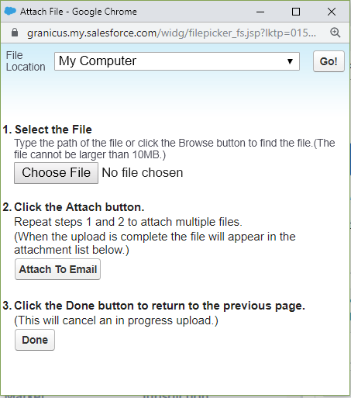
Email Attachments
Upload Files or Use Case Attachments
Upload files: 3 steps
Choose File
Attach to Email
Repeat top two for additional attachments
Done

Slide 61
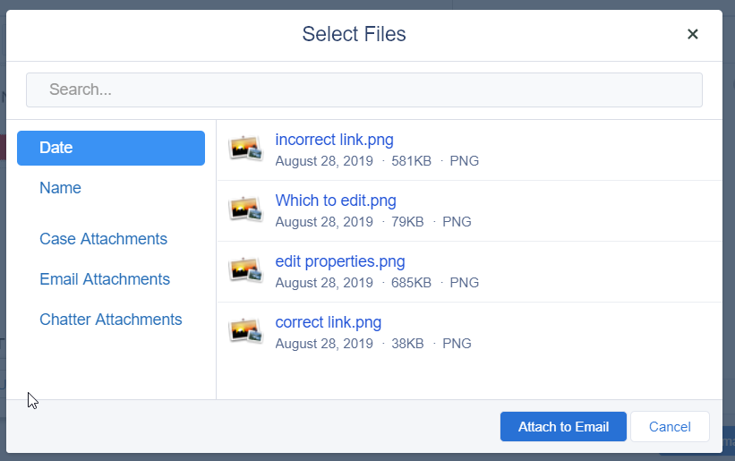
Email Attachments
Upload Files or Use Case Attachments
Use Attachments
Select case files to attach
Click ‘Attach to Email’

Slide 62
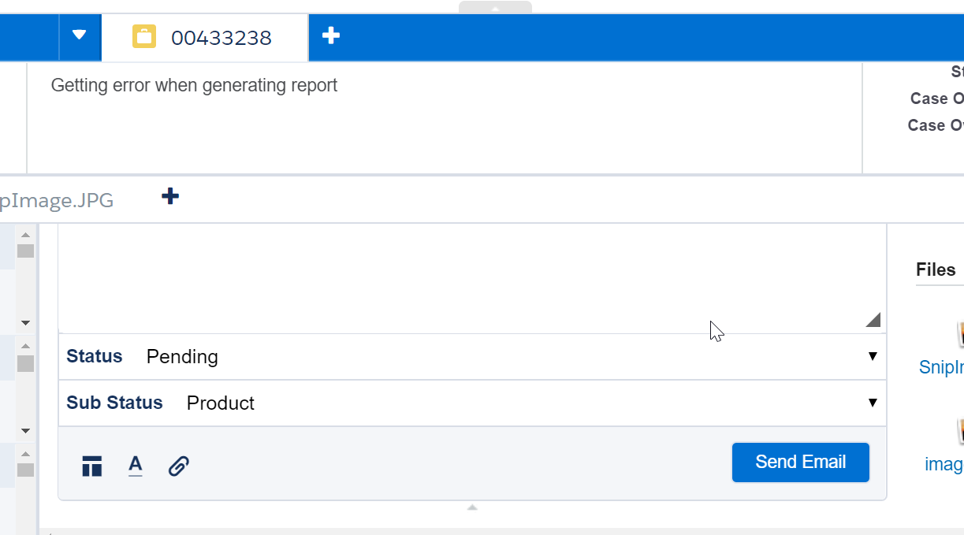
Setting the Case Status
Change the case status before you hit send!
This is the easiest time and place to update the case status in the case
At the bottom of the email, use the dropdown to set the case Status and Sub Status
Click ‘Send Email’to both send email and update case status

Slide 63
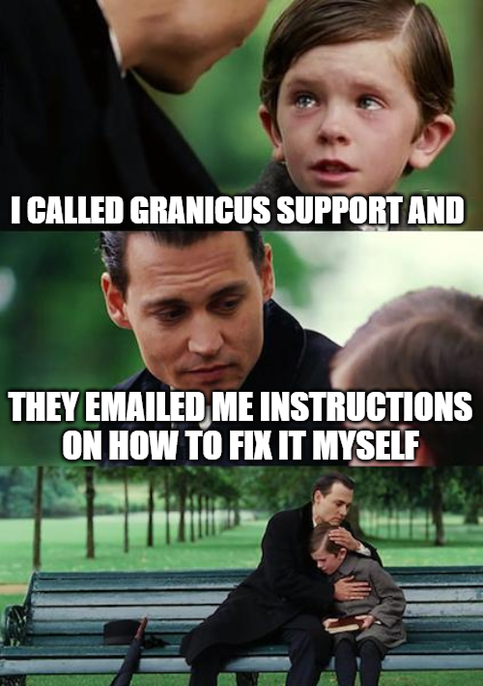
Time to send some more emails
Send two more emails, each with a different type of attachment
Change the case status to something different for each email

Slide 64
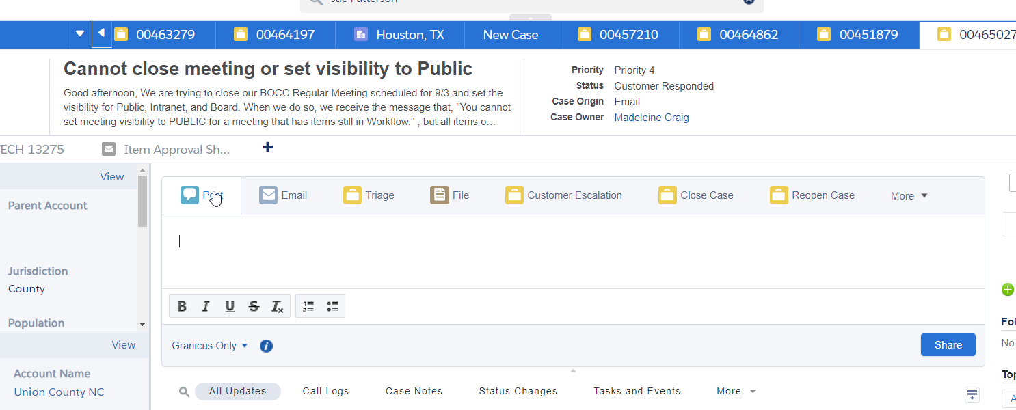
Post
Internal Communication w/ Other Agents, Developers, TSE Members and Designers
You need to be in the Feed View to make a post
Click the ‘Post’ button at the top of the Feed View
Compose Post
Click ‘Share’

Slide 65
Post
Tagging in a post
Tagging a person: use the @ symbol and start typing the person’s name after the @ (e.g. @madeleinecraig)
Tagging a person will send an email to that person with the contents of the post
The tagged person can also comment on your post, and you will be emailed the content of those comments
Tagging JIRA: type #JIRA to tag any JIRA cases linked to the case
Tagging JIRA in a case will include the post as a comment in the JIRA ticket
If the JIRA ticket has been assigned, the person assigned to that JIRA will also receive an email

Slide 66
Case Management
Status and Sub Status, Hand-Offs and Escalations

Slide 67
Case Statuses
New
Assigned
Open (deprecated)
Pending
Customer Responded
JIRA Responded
Reopened

Slide 68
Case Status Overview
1
2
3
New
Assigned
Pending
The status of a case when it is first created, but not assigned
The status of a case when it is assigned to an agent, but no action has been taken yet
The case is waiting on services on a specific team or awaiting a response from the client
4
5
6
Customer Responded
JIRA Responded
Reopened
Status that automatically appears when a client responds to an email in the case
Status that automatically appears when any of the Tier 2 teams to which the case has been escalated have responded
A case that has been reopened after it was closed. This most often happens if a client responds to an email after a case was closed

Slide 69
Pending
This status should always also have a sub-status
A pending sub-status depends on the team whose services it is waiting on
Customer – the case is awaiting a customer response
A case with this status will trigger a series of emails reminding the client that we are awaiting information from them
If the client does not respond after a period of time, the case will automatically close
Support – waiting to be worked by the support agent

Slide 70
Pending
This status should always also have a sub-status
A pending sub-status depends on the team whose services it is waiting on
Engineering – waiting to be worked by TSE or Development
Services – waiting to be worked by the Granicus Professional Services (aka Design)
Product – waiting to be worked by the product team (cases due to bugs)
This status is used for cases created for product bugs
There are additional sub-statuses, but they are rarely used

Slide 71
Handing Off Cases to Other Teams
LIVE DEMO
Sales
Design
Implementation
OneTimeFeeRequests
Ignite Team

Slide 72
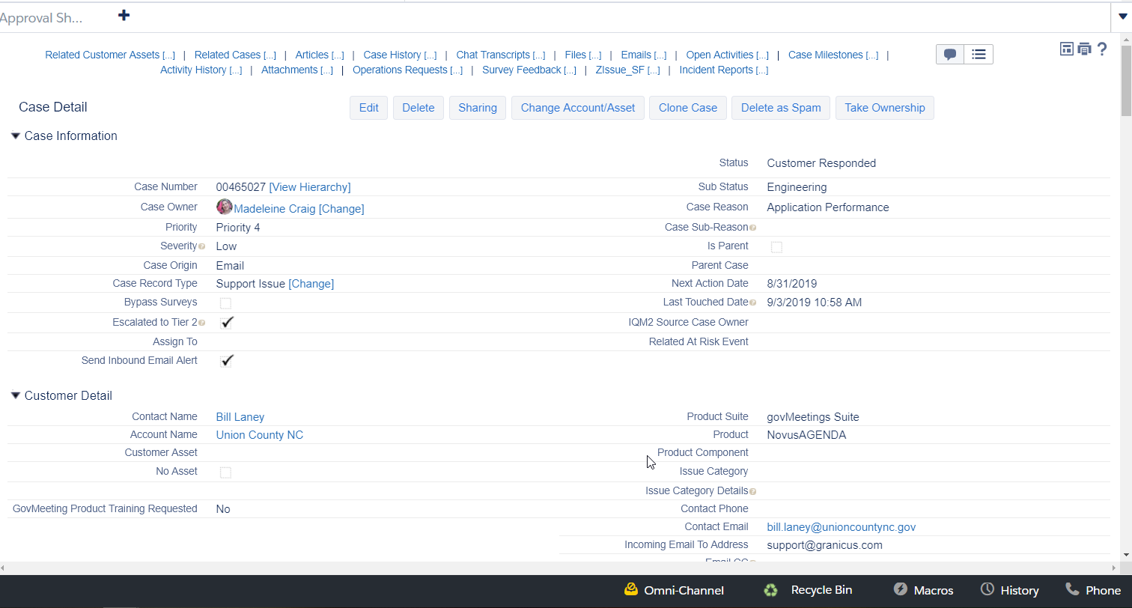
Handoffs
Each type is a little different with some common elements
Many of these handoffs require to change two fields:
Case Owner
Case Record Type
Some require you to use the Macros tool

Slide 73
Escalating a case
Officially alert Customer Support managers of a case that is getting critical

Slide 74
Escalating a Case
You need to be in the Feed View to Escalate a case
Click the ‘Customer Escalation’ button at the top of the Feed View

Slide 75
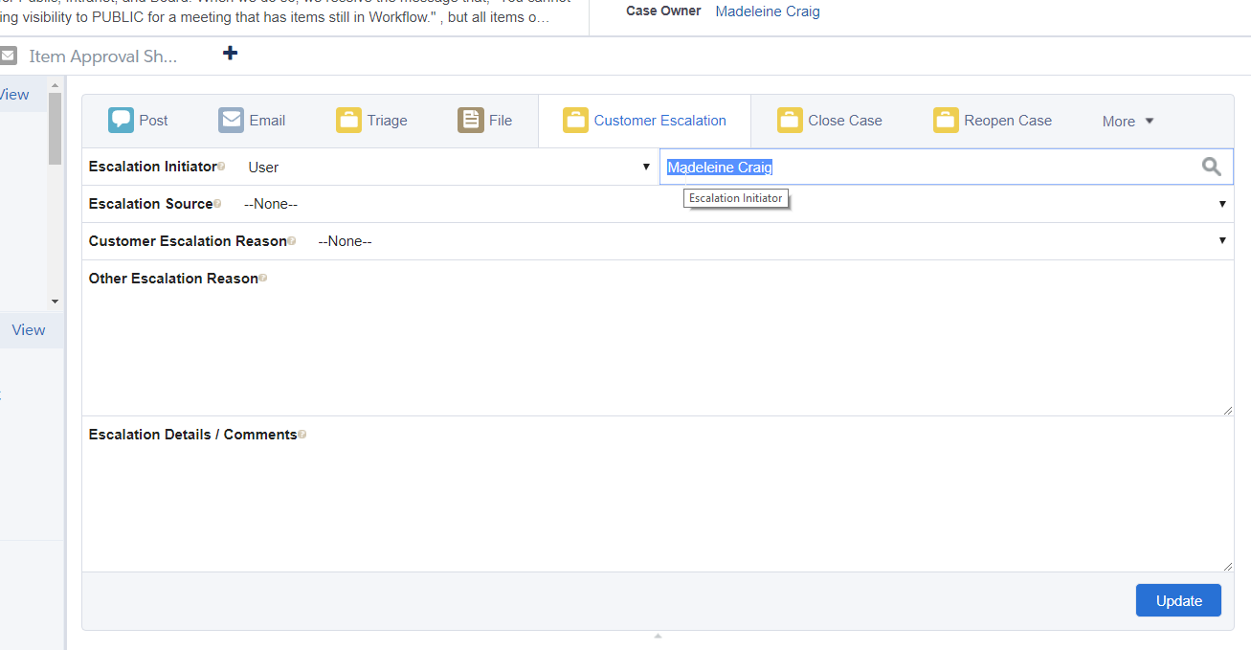
Escalating a Case
Select the appropriate Escalation Source and Customer Escalation Reason
Fill in Escalation Detail
Click ‘Update’
Ping Support Leads and or Managers with case details

Slide 76
Closing Cases
The Ultimate Objective

Slide 77
Closing Cases
You need to be in the Feed View to close a case
Click the ‘Close Case’ button at the top of the Feed View

Slide 78
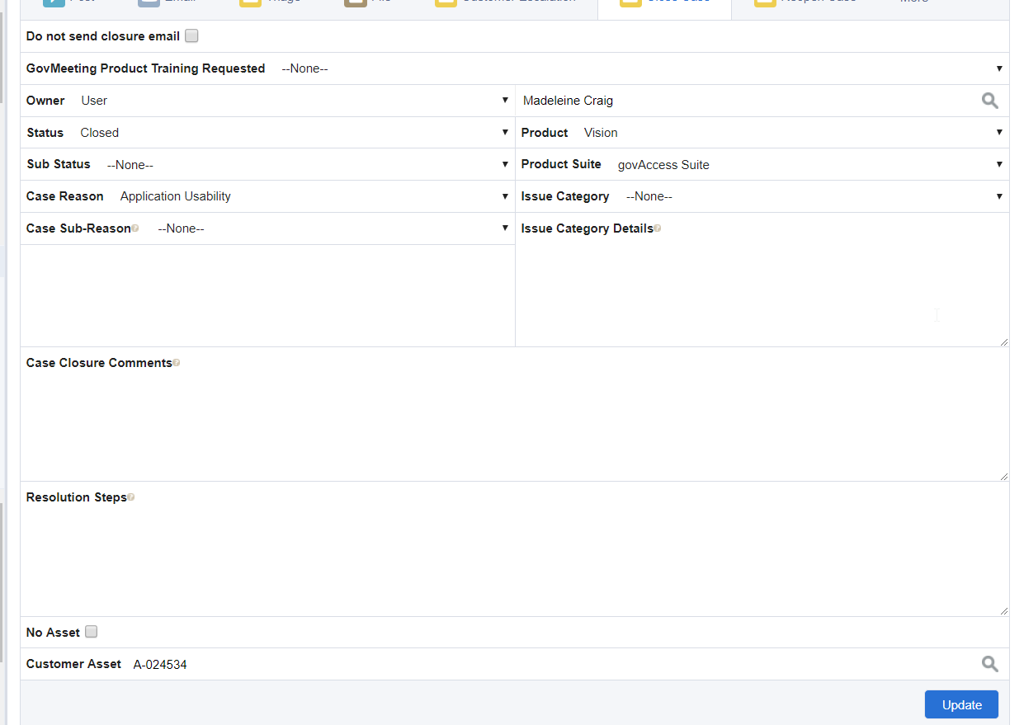
Closing Cases
The Close Case Window
Do not send closure email checkbox
When reclosing a case when the client has responded to a final case email with a simple thank you
In rare cases, used when you need to stealth close a case

Slide 79
Closing Cases
The Close Case Window
Sub Status dropdown
Depending on the case sub status, a case closure email may or may not be sent
We’ll review closure sub statuses in another slide

Slide 80
Closing Cases
The Close Case Window
Issue Category dropdown
This is a required field for all govMeetings cases
It will eventually be required for all products
Issue Category Details field
Required when issue category is ‘Other’

Slide 81
Closing Cases
The Close Case Window
Case Closure Comments field
Information regarding case resolution.
Information typed in this field will be included in a case closure email if one is sent.
CS Leads and Managers can see this content after the case is closed, but agents can’t

Slide 82
Closing Cases
The Close Case Window
Resolution Steps field
if there is specific process which led to resolution, it can be included here.
The information entered here is for internal use only. It is not shared with the customer

Slide 83
Closing Cases
The Close Case Window
Do not send closure email checkbox
For reclosing a case when the client has responded to a final case email with a simple thank you
In rare cases, used when you need to stealth close a case

Slide 84
Case Closure Sub Statuses
The Case Closure Sub Status can trigger, or abstain from triggering, an automated case closure email

Slide 85
Closing Cases
Case Closure Sub Statuses
Most cases, you will not touch this field
In these cases, the sub status will pull from the case sub status
There are times when you will want to manually select a sub status

Slide 86
Closing Cases
Closed Case Sub Statuses
Duplicate – when the case is a duplicate of another case. This status in theory will not send case closure email. Include case number of duplicate case in case closure comments. You can click the ‘Do not send closure email’ as well for good measure.
Feature Request – when the case type is a feature request. This status also will not send a case closure email
Spam – when the case is spam. This is the only status that will allow you to close a case that does not have an owner

Slide 87
Closing Cases
Closed Case Sub Statuses
Sales – when the case has been handed off to a sales team and a sales task has been created for an account owner
Billing – when the case has been handed off to accounts receivable or it is a case that can only be handled by AR. Client should be advised to email ar@granicus.com. If the client is particularly frustrated, you can also email AR directly on the client’s behalf.
Hand-Off – when a client has requested something that requires a quote. Send email to OneTimeFeeRequests@granicus.com and then close case as a Hand-Off
OpenAir Case – when a case has been transferred to Implementation

Slide 88
Case Closed Emails
Official notification to the client that a case is closed

Slide 89
Closing Cases
Closed Case Sub Statuses
These are sent to the client when the case is closed unless the ‘Do not send closure email’ box is checked or the case has a sub status that foregoes the case closure email.
They include the basic case information (number, subject) and anything written in the Case Closure Comments field.

Slide 90
Customer Satisfaction Surveys
A customer satisfaction email that is sent to a client a few days after a case is closed

Slide 91
Closing Cases
Bypassing Surveys
You can prevent the customer satisfaction email from being sent by bypassing surveys
You must be in the Case Details View to bypass surveys
Bypass surveys when closing case as a duplicate
Bypass surveys if it would be appropriate to stealth close a case – i.e. another email from us would further escalate client’s frustration

Slide 92

Time to close some cases
Close the test cases you made

Slide 93
Reopening a case
When the issue is not resolved as previously thought or it closed for lack of response

Slide 94
Reopening Cases
N.B. A case will automatically reopen if a client responds to a case email within two weeks of case closure
You need to be in the Feed View to reopen a case
Click the ‘Reopen Case’ button at the top of the Feed View

Slide 95
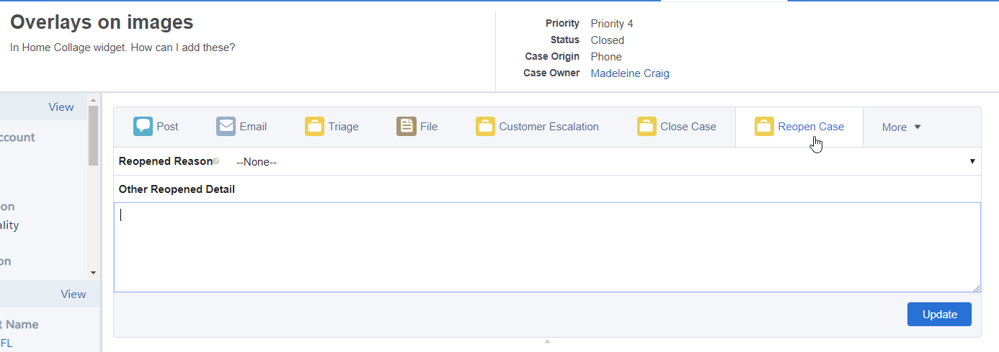
Reopening Cases
Select the Reopened Reason and enter any Other Reopened Detail
Click ‘Update’

Slide 96
Time to reopen some cases
Reopen the cases you just closed
Close them again

Slide 97
Salesforce Best Practices

Slide 98
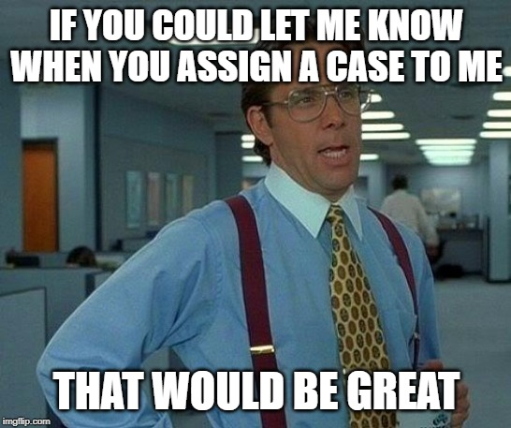
Salesforce Best Practices
Etiquette when assigning cases to others
Connect with the Support Agent with details of the case before assigning a case to them
Message agent with the case number
Ping the agent from within the case so they receive an email notification as well

Slide 99

Salesforce Best Practices
Looking for other cases from the same account
When in a case queue, click the ‘Account Name’ header to sort cases by account name
Take multiple cases from the same account for efficiency

Slide 100
Questions?

Slide 101
Thank you
Madeleine Craig| madeleine.craig@granicus.com

