Slide 1

Talkdesk
Call Management Application

Slide 2

Logging On

Slide 3
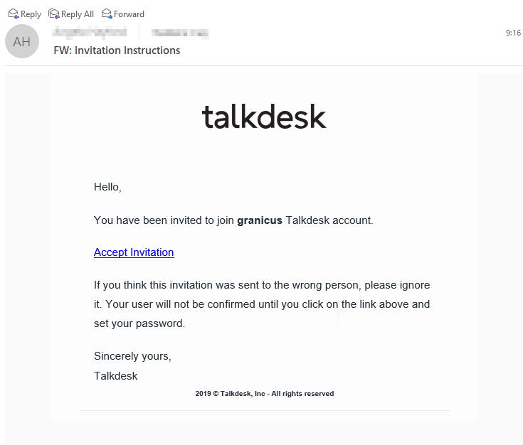
Your Talkdesk Invitation Email
Click ‘Accept Invitation’
Create your account credentials
Go to:
https://granicus.mytalkdesk.com

Slide 4
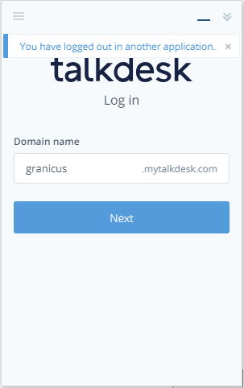
Insalling Callbar
Download Callbar at:
https://downloadcallbar.talkdesk.com/download.html
Type Granicus before ‘.mytalkdesk.com’
Click ‘Next’ to enter login credentials
Pro tip: Pin the Callbar app to your task bar

Slide 5
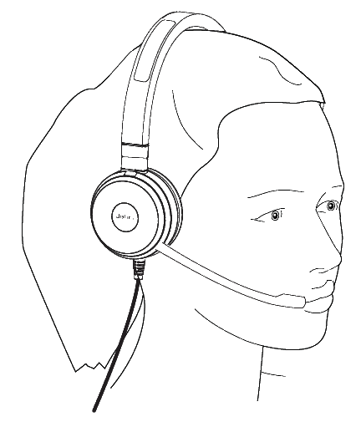
Your Headset

Slide 6
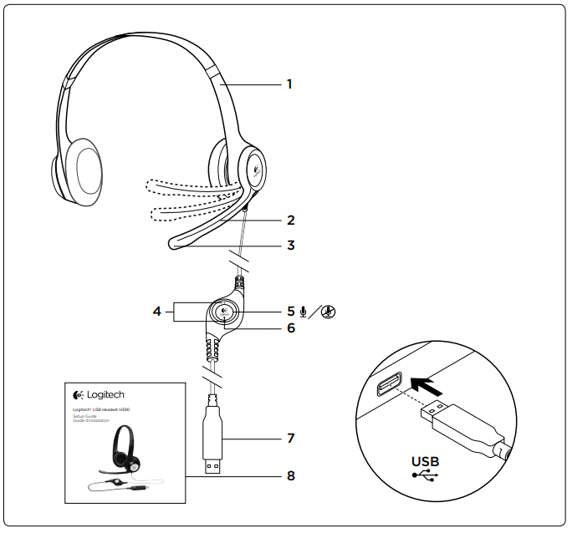
Your Headset
The Best Call Device
How tos:
Volume
Mute
Microphone Position

Slide 7
Callbar Settings

Slide 8
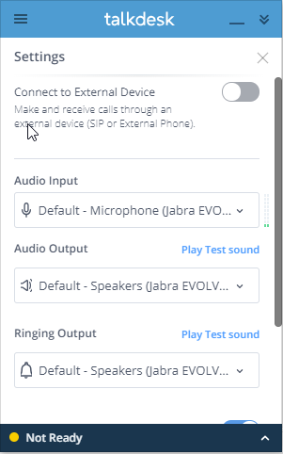
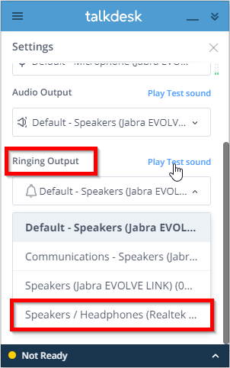
Audio Input/Output
The audio input/output is your headset by default.
Some agents prefer to have the ringing output come through their computer’s speakers or headphone jack output if they don’t want to wear the headset all the time.

Slide 9
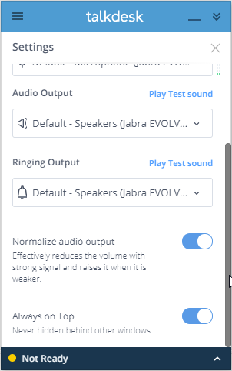

Other Settings
The bottom two settings are typically on, but can be changed to suit your preference
Pro tip: Set the Callbar to be always on top, but minimize it to keep it from blocking other content on your screen

Slide 10
Making a Call

Slide 11
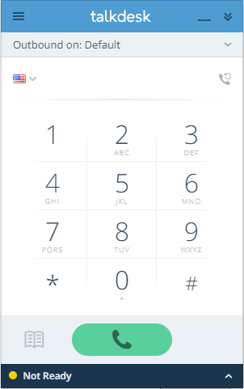
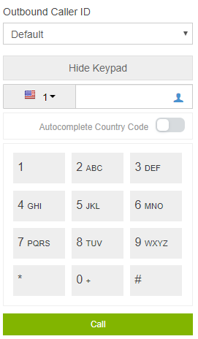
Making a Call
Very straightforward
Copy and paste a number in the number fields
Or use the keypad
You do not need to type the country code

Slide 12

Receiving a Call

Slide 13
Setting Your Call Status
To receive an incoming call, your status must be set to Ready
Click the status in the lower left to change your status
You can receive transferred calls in either a Ready status, or any Not Ready (Yellow) status

Slide 14
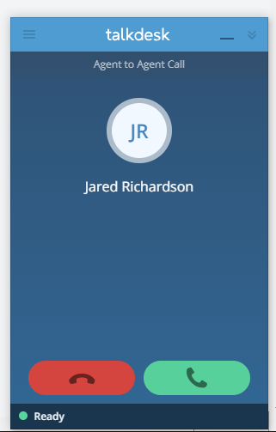
Receiving a Call
When a call comes in, click the green answer button to answer a call
Click the red reject button to reject the call – the call will go back into the queue
Caller name and information will be displayed if available, though it is not always correct

Slide 15
During a Call

Slide 16
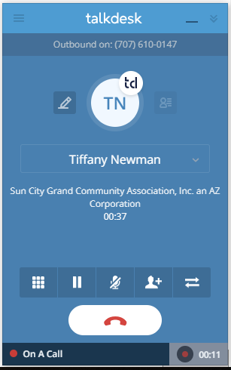
During a Call – Icon Functions
Keypad icon
Hold icon
Mute icon
Conference call icon
Transfer icon
Hang up button
Pause the recording (if client is sharing sensitive information)
Add a 3rd party for a conference call
Mute microphone
Transfer call
Access the keypad
Pause recording
Place caller on hold
Hang up

Slide 17
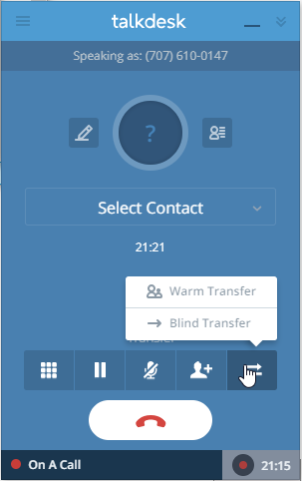
Transferring a Call
Click the Transfer Icon
Select the transfer type
Warm Transfer: allows you to speak privately with the agent to discuss before completing the transfer
Blind Transfer: transfers directly the agent

Slide 18
Transferring to a Product Queue
To transfer to a Product Queue, that product queue must have agents in ready
Choose Blind Transfer

Slide 19
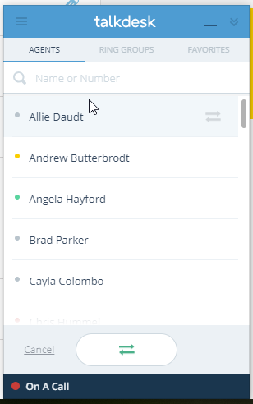
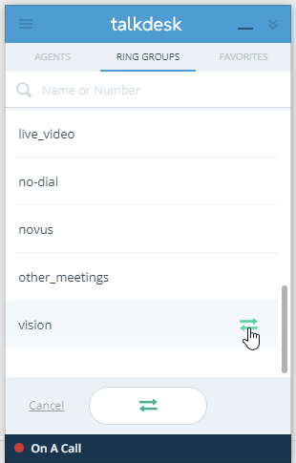
Transferring to a Product Queue (Cont.)
Click the Ring Groups tab
Highlight the appropriate Product Queue
Click the transfer icon

Slide 20
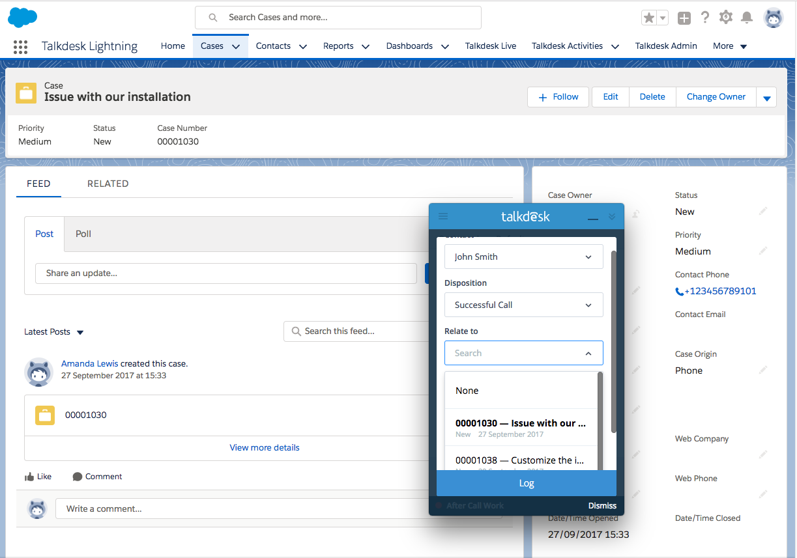
Relating a Call to a Salesforce Case
Once a call is completed, it can be related to an existing case in Salesforce
In the call disposition window, potential related cases will come up
You can choose one of those or search for a case number

Slide 21
Reporting

Slide 22
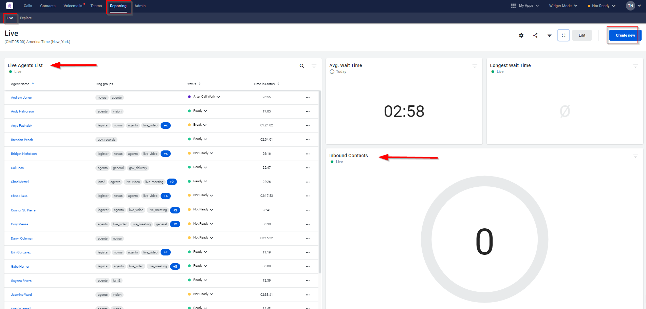
Reporting Dashboard
Service Level
Longest Wait Time
Click on any number on the bottom of the dashboard to see:
Who is in Ready
Busy
Away
After Call Work
Calls in Progress
Queued Calls w/ Product Info and Wait Time

Slide 23
Voicemail

Slide 24
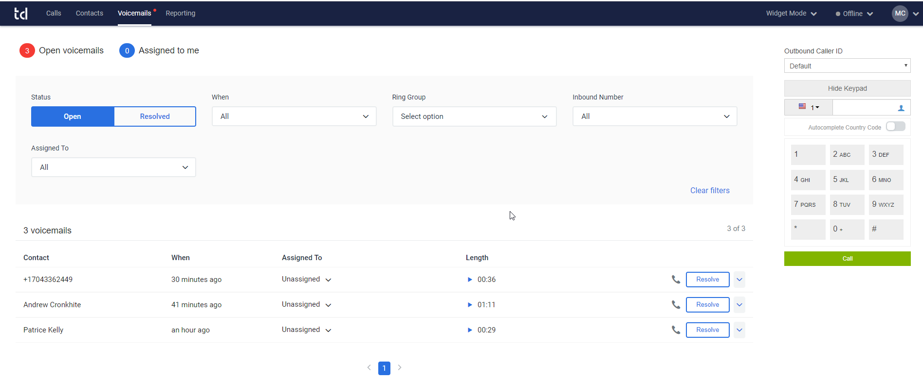
Voicemail
Listen
Assign
Resolve
Case

Slide 25
Salesforce Chat and Talkdesk Integration
Case Management and Best Practices

Slide 26
Before You Get Started
For chat to work, you must be in Lightning or the Support Console view, not the Classic view
If you navigate to the Classic view, you will need to re-load the page for chat to work
If you do not re-load, chats will still come to you, but when you open them, you will not see the chat window

Slide 27
Salesforce and Talkdesk Integration
Statuses are linked between Salesforce Chat and Talkdesk
You can receive up to 2 chats (and a 3rd if it is transferred to you)
If you are actively on a chat, Talkdesk will update your call status so you are unavailable for calls*
If you are on a call, Talkdesk will also update your chat status so you are unavailable for chat*
*Not currently working

Slide 28
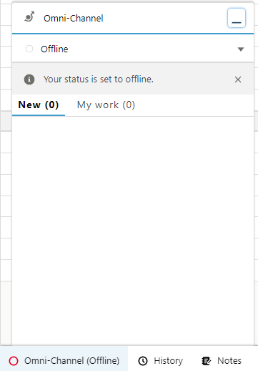
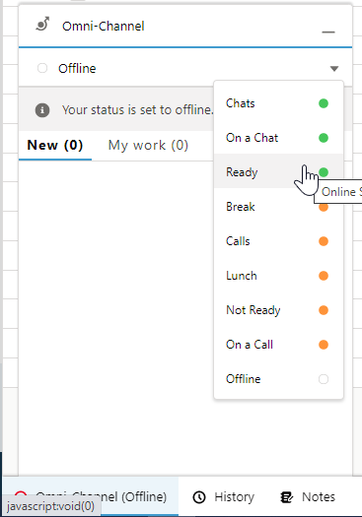
Logging Into Talkdesk
For Talkdesk/Chat to sync statuses you must log into Talkdesk via Salesforce-Omni-Channel and then log into the call bar.
Currently, these are separated.

Slide 29
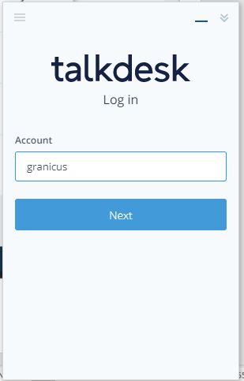
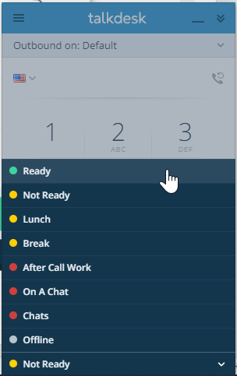
Logging Into Talkdesk (cont.)
Complete Talkdesk log-in by logging into Talkdesk, and then the Talkdesk Callbar.
By default, logging in will place you in a “not ready” status for both phones and chat.
Note: Setting Talkdesk status to “offline” will not update chat but logging out will

Slide 30
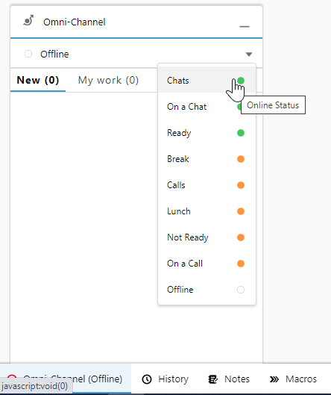
Accessing Chat Status
Again, for chat to work, you must be in the Support Console - To take a chat, you must be logged into chat.
Click ‘Omni Channel’ in the lower left of your Salesforce screen.

Slide 31
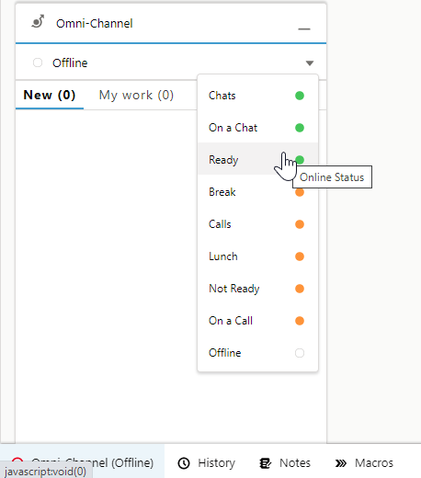
Accessing Chat Status (cont.)
Set your status to ‘Ready’
Update your status as needed
This will also update your Talkdesk status
Note: Setting Chat status to “Offline” will also set Talkdesk to “Offline” but not vice versa

Slide 32
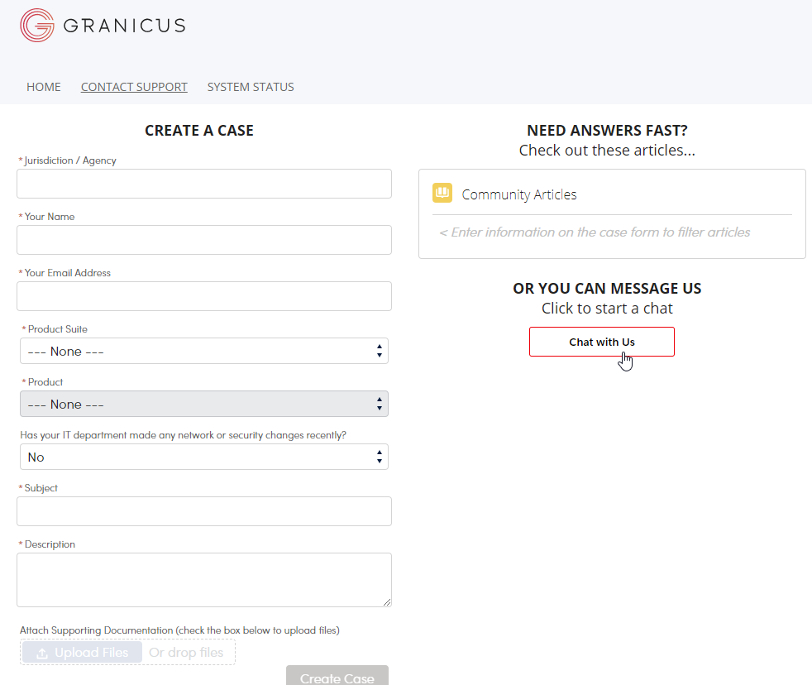
The Client Experience
Client clicks the ‘Chat with Us’ button on the Contact Support page on the Granicus website

Slide 33
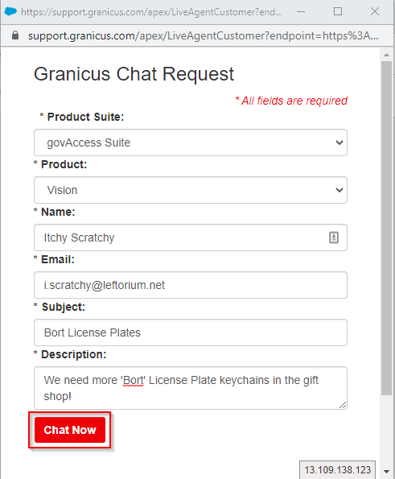
The Client Experience (cont.)
A Granicus Chat Request window pops up
Client fills out required fields and clicks ‘Chat Now

Slide 34
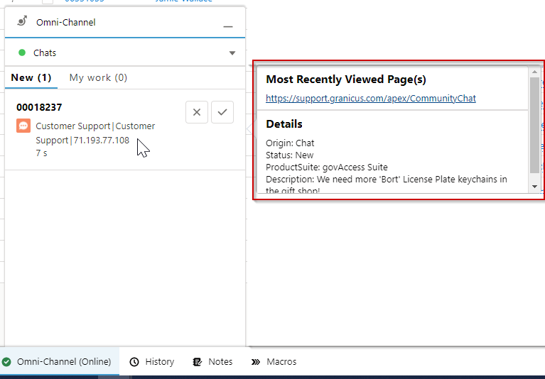
Accepting a Chat
You can preview the subject of a chat by hovering over the chat
This will trigger a pop-up of the chat details

Slide 35
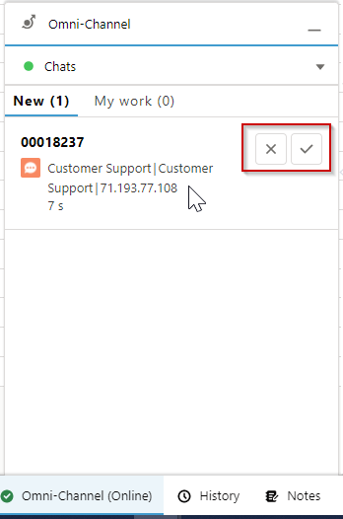
Accepting a Chat (cont.)
When a chat comes in, a window will pop up from Omni-Channel
Click ‘Accept’ to take the chat, or ‘Decline’ to decline it.

Slide 36
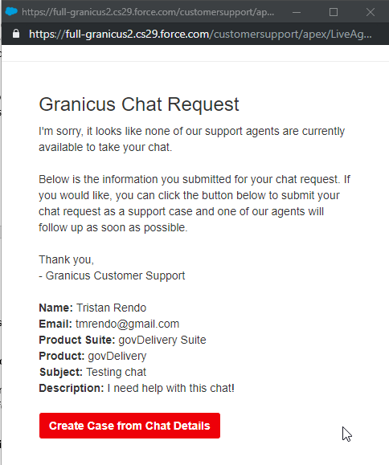
Accepting a Chat (cont.)
If no agents accept the chat, the client will receive a message saying there are no agents available.
They can then create a case from the chat details they submitted.

Slide 37
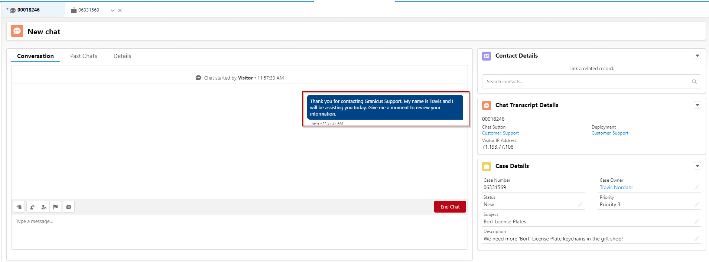
During a Chat
When a chat is started, all clients receive the following message:
Thank you for contacting Granicus support. My name is [your name] and I will be assisting you today. Give me a moment to review your information.

Slide 38
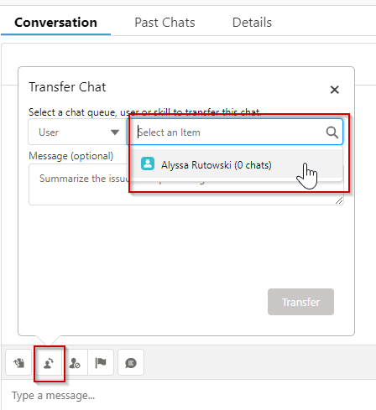
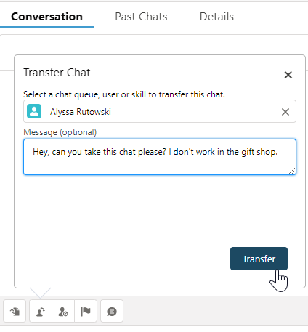
Transferring a Chat
To transfer a chat to another agent, click the blue transfer icon in the upper left of the chat window
You can summarize the issue and let the agent know why you’re transferring the chat in the Message box

Slide 39
Chat Etiquette

Slide 40
General Guidelines on Chat Etiquette
While some clients will become very conversational in tone, treating it much like a slack conversation among coworkers, we should remain professional:
Avoid “text speech” like “LOL” or “OMG”
Be mindful of making jokes (especially sarcasm); tone is not well conveyed in a chat and is easy to misunderstand
Use simple emojis (☺) sparingly

Slide 41
Managing the Chat
Update the client periodically to keep the client engaged. (Also keeps chat from timing out)
If client struggles to understand or the issue is complex, suggest a phone call
If the issue cannot be resolved on the chat, let client know a case is being created and you will follow up via email or phone, per their preference
Confirm with the client that it is OK to end the chat:
Thank you for reaching out today and I hope I’ve been able to address all of your questions. Is there anything else I can assist with today before ending this chat?

Slide 42
Questions?

Slide 43
Thank you

