Slide 1
Content Rationalization
Martha’s Vineyard Commission
Jasmine Ward
November 13th, 2024

Slide 2

Agenda
Today we’ll cover…
Use-case
Scope
Content Rationalization
Questions and next steps

Slide 3


Let’s take a trip!
5-day beach vacation to an all-inclusive resort in the Caribbean
What I know I want to do
But ask yourself…
Relax and not be rushed
What if I want to go scuba diving?
What if I want to play golf?
Lay out on the beach and tan
What if I go on a jungle excursion / trail run?
What if there is an occasion where I need to dress up?
Read my book
What if I need to dress up every night?
What if it gets cold?
Spend time with my family
What if it gets really cold?
What if it gets really hot?
Eat delicious food in mass quantities
What if aliens… What if zombies…
What if…

Slide 4


This is what happens with “what if…”
Primary use-case
What if (edge-case)
A single piece of luggage
4-5 bags, golf clubs, etc…
Notes:
What kind of packer are you?
swim suits
warm weather
cool weather
scuba gear
golf clubs

Slide 5

Where is the “thing” I’m looking for?
Elaborate architecture (or packing schemes) can attempt to organize our bloated content, but it doesn’t remove complexity or reduce cognitive load for our visitors.
We pack the bags – then send our residents to find the “things” in the bags we packed.
Assumptions that residents know (or care) about the structure of government.
Notes:
how does it relate
I pack and where is the sunscreen
Where is it?
elaborate (lots) – end of the day, it doesn’t reduce the complexity
We’re assuming site visitors know or care about where the info is

Slide 6


Start with Data
What are people doing on your website today?
What are people calling about, walking in for, and emailing you about?
How do we know what’s most important?
Notes:
Data tells a story about what is important to them
telling us a story
tell us how they want to interact
what do they want

Slide 7

Poll
How many pages does your website currently have?
< 300 pages
300 to 600 pages
600+ pages
Notes:
Do you know how many pages you have?
how much content you have vs how much is being used

Slide 8
Here’s some data to get you started
We took a year of Google Analytics data for 50 Cities across the US – removed the duplicates, noise, and bad URLs to find out, “how many pages drive 80% of a sites traffic on average”.
Varying page traffic as high as 10M page views down to 100k
80% of website traffic is driven by x pages / 85% by x / 90% by x pages
 | 80% | 85% | 90%
Median | 100 | 138 | 204
Average | 117 | 168 | 266
Notes:
big cities and small cities
based on 80% of the website traffic, it’s being served by 117 pages

Slide 9
Stay focused on primary user objectives
Drop off after 80% - bad ROI
Focus on primary use-case (80%) and deal with edge cases later as time permits, and you iterate better.
 | 80% | 85% | 90%
Median | 100 | 138 | 204
Average | 117 | 168 | 266
CITY SITE | 80% OF THEIR PAGES | SAME | SAME

Slide 10
Organizational Alignment
Drop off after 80% - bad ROI
Focus on primary use-case (80%) and deal with edge cases later as time permits, and you iterate better.
 | 80% | 85% | 90%
Median | 100 | 138 | 204
Average | 117 | 168 | 266

Slide 11

Organizational Alignment
Or not…
Where are we as an organization and who is on board with packing only what we really need?
Leadership
Departments
Content contributors
How do we get there?
There must be a champion to have the conversation, but it takes a village to be successful.
Notes:
are we fully aligned
this team is on board, of course
do our departments or other content contributors, leadership, are they aware of the changes that you’re thinking about making these changes
your team are the champions
let the data guide you

Slide 12

Great news!
Better UX with less work
Powered by Prioritization
Rationalizing less ”edge-case” content = less work
Creating effective information architecture for less content = less work
Laying out a website focusing on the primary use-case = less work
If you’re creating a new website, migrating less content = less work
Notes:
Data might say one thing, but other departments may have different reason to keep their content that they’re married to
We’re getting rid of that stack of suitcases
less digging around, less frustration

Slide 13




How do we make it easy
for people to…
Find what they
are looking for
(without understanding the business of government)
Understand what
they need to do
(in plain English and clear step-by-step instructions)
Get it done, then
and there
(at any time, on any device, with minimum steps)
Be delighted,
become engaged
(without asking, based on implicit needs)
Notes:
users can come into your website
find what they need easily
understand what they need to do if it involves action
They can get it done right there
and they may learn something in the process and want to come back
less people having to reach out for help

Slide 14


Content Rationalization
What gets migrated? What doesn’t get migrated?
Do Not Migrate
Migrate
Content retired and not migrated
Content migrated as-is by Granicus
Notes:
we migrate what you want us to – as close as we can with the tools in the product

Slide 15
Rationalizing Content
What gets migrated? What doesn’t get migrated?
Do Not Migrate
Migrate
Low page views
Outdated
Unnecessary
Redundant or duplicate (1 source of truth)
High page views
Useful or relevant
Task-driven
Required (legal)
Notes:
If there’s other content maintained elsewhere, link out to it as opposed to replicating it.

Slide 16


What’s in scope?
600 pages
Up to 600 pages of public content migrated from your existing website
Your URL
https://mvcommission.org/
Notes:
This does not mean your site is completely limited to that 600 pages, just that Granicus will migrate up to 600 pages (and page equivalents). you can migrate and/or create many yourselves.

Slide 17
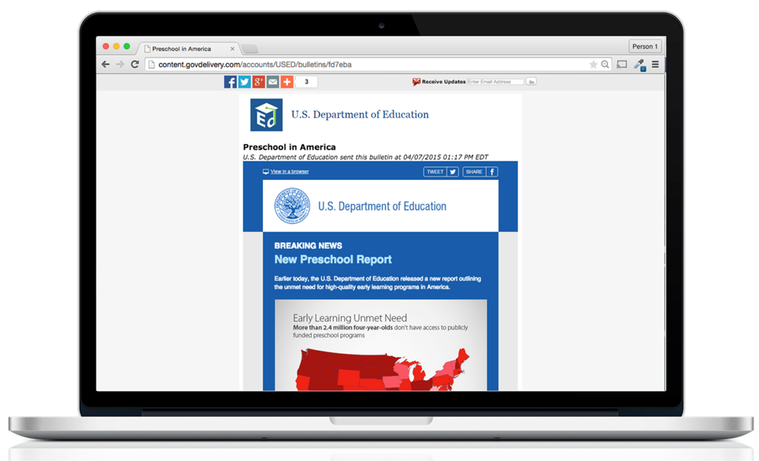
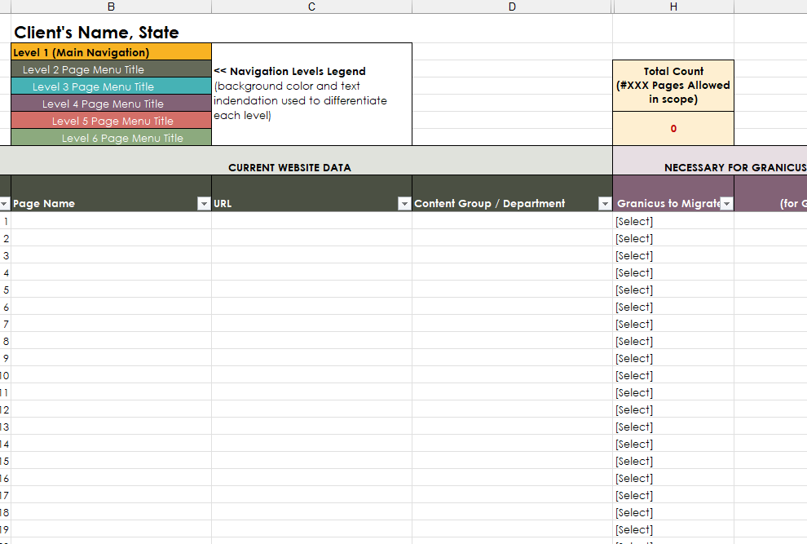
Content Rationalization Worksheet
Archive or Migrate
Granicus provides a spreadsheet that lists all the pages that are publicly available on the website. Your team reviews each page to determine the action:
Migrate
Do not migrate

Slide 18
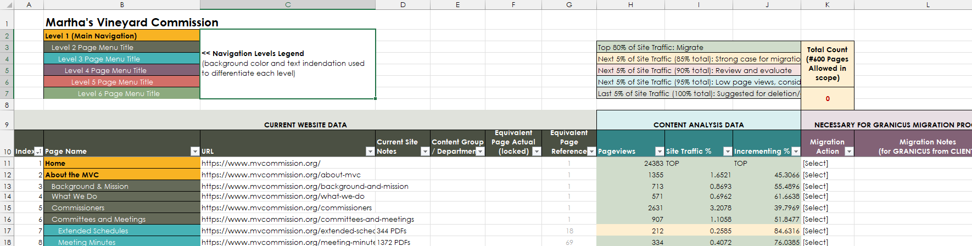
Content Rationalization Spreadsheet
Current Website Data
Columns A, B, and C show the index, page name, and current URLs
Column D shows notes from our Content Migration Specialist that populated the sitemap
Column E is for you to identify the department to which this page belongs
Column L is there for you to leave any notes for our team, if so desired
Notes:
Please note that there are some fields that are locked with a few formulas that we’ve included.

Slide 19
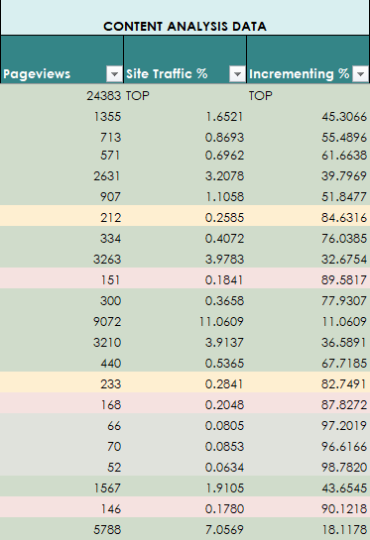
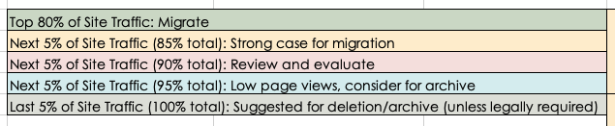
Content Rationalization Spreadsheet
Content Analysis Data
The Content Analysis Data section displays site traffic data from your URLs for the past 12 months. These columns can be filtered as needed.
Notes:
New Notes: There were some pages that showed up in the analytics that weren't in my initial sitemap. Most of them have been added to the end under "Additional Pages" as they aren't anywhere in the main navigation, and a lot of them are older and might be out of date. I was able to place a few of them in the main sitemap, but I added those due to them being related content that most likely belonged in those sections.
I added "TOP" to the homepage url for calculating the site traffic percentages, because the page views for it were SO much higher than the rest of the pages on the site and it skewed the numbers. General CRW worksheet Notes: The only manual process is when copying from the rationalization tab to the proposed site map tab, you/the client will need to paste special - VALUES...just to make the equivalent page count paste over instead of the formula. If that doesn't make sense, please reach out! - Data was pulled for one (1) year - News, events, and directory items are not included in these worksheets. - Redirects, Expired pages, pages that have never been published, and hidden pages that are obviously old/not in use/blank (and have no data) are also not included. If there was a page that had no data, but was questionable in terms of its current relevance, I DID include it in the rationalization.

Slide 20
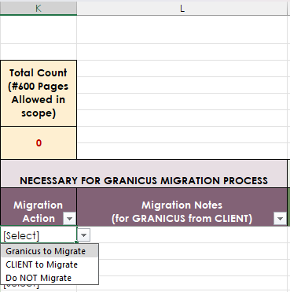
Content Rationalization Spreadsheet
Granicus Migration
Column K allows you to indicate how each page is to be handled:
Granicus to migrate
Client to migrate
Do not migrate
The “total count” will increase as you work through the list so you can easily see if you are within the contracted number of pages. If you have notes to share with the migration team, those can be left in column L.

Slide 21
Content Migration
Page Equivalents
It is important to understand how certain elements of content translate into your overall page count.
Example
A page contains body content and 25 documents. That page counts as 2.
Excessive Content
When reviewing the Content Rationalization spreadsheet, if the content team finds any sections of content like a document repository or an image gallery that translates to more pages than what is in scope, that is considered excessive content. The Content Lead will collaborate with the client team on a path forward.
Type of Content | Page Equivalent per Item
Pages | 1:1
Documents | 20:1
Images | 20:1
FAQs | 10:1
FAQs replicated as accordions | 20:1
Accordion sections | 10:1
Bids/RFPs/RFQs | 1:1
Job postings | 1:1
Business listings | 1:1
News articles | 1:1
Events | 1:1
Parks/facilities | 1:1
Staff listings | 1:1
Notes:
If you have a page with 100 documents, it’s more work than just a page, but we do have some rules for equivalent page counts

Slide 22

Content Migration
Tracking Changes
The client team is responsible with documenting changes to content during and after Content Rationalization. This includes pages added or removed.
Any new edits not captured in the spreadsheet will be the responsibility of the client team to make on the new website once it is handed over.
If new pages are created…
During rationalization: Add them to your spreadsheet.
After rationalization: Document them internally. You can add them to the site after migration.
If pages are deleted…
During rationalization: Remove them from the spreadsheet.
After rationalization: If marked for migration, let us know so we don’t migrate them.
Notes:
date pulled:
If you added pages, please add in the page
These are a list of publicly available pages
If removed a page, just delete it from the list
Freeze date, once approved, need to keep track

Slide 23

Content Rationalization
Questions to ask
Think like a resident! Think like a subject matter expert!
When was the last time this content was updated?
How many page views does this content receive?
What is the purpose of this content?
Who is interested in or benefits from this content?
Is this content required? By whom and why?
Is this content useful? Does it involve task completion?
If this content was archived, who would be affected?
Notes:
what to think about as you’re going through it
who is affected if you remove the content, etc

Slide 24

Content Migration
What’s not in scope?
Migration of:
System pages inherent in previous CMS – govAccess has its own
Test pages, duplicates, internal redirects, etc.
Interactive elements, JavaScript, or other custom code
Interactive web forms
Time-sensitive information such as news and calendar events
Documents and images on pages marked “Do not migrate”
Notes:
Do you have interactive forms on the site?
Are they embedded, PDF, or part of CMS?
pages that you do not want us to migrate, those documents and images will not be migrated either
unless they live on another page that is marked for migration

Slide 25
Questions?
Notes:
now show spreadsheet

Slide 26
Next Steps
After this call…
Client Team​​ | Granicus Team​​
Use the provided spreadsheet to rationalize content. | Send recap of today’s call including Copy of presentation Content Rationalization spreadsheet ​​ ​​

Slide 27
Thank you!
Email: jasmine.ward@granicus.com
Phone: 720-679-5812
Hours: Monday through Friday, 9 am to 6 pm ET

